Slide 1

This project is supported by the Health Resources and Services Administration (HRSA) of the U.S. Department of Health and Human Services (HHS) under grant number U1QHP28735. Its contents are solely the responsibility of the authors and do not necessarily represent the official view of the Health Resources and Services Administration or the U.S. Department of Health and Human Services.
ICARE
Infection Control Advocate & Resident Education
Notes:
Script
Welcome to ICARE- Infection Control Advocate and Resident Education

Slide 2
Infection Control Advocate and Resident Education
Protect Yourself and Others:
Less Antibiotics, More Vaccines
Notes:
Script:
In this lesson, we will cover how limiting antibiotics but promoting vaccinations can help protect yourself and others in the nursing home community.
Ombudsman Notes:
Lesson Main Messages:
Both vaccines and antimicrobial drugs, including antibiotics, can have impact not just a resident’s health but the health of all other residents in the nursing home community.
Appropriate antibiotic use includes using the right drug, dose, duration, and administered in the correct way
Certain vaccines must be offered to nursing home residents to reduce their risk of severe outcomes such as pneumonia
Lesson Materials:
Link to online lesson: https://rise.articulate.com/share/nZowV1PZDZNcS-Ao_tncX854HYBnjb8s
Handout- ICARE: Less Antibiotics, More Vaccines
Additional handouts can include:
Preserve My Rights, Prevent Infections!
Infection Prevention and Control: Regulations & Requirements
Resident Care Roles: Medical Services
Resident Care Roles: Nursing Services
Total Teach Time: ~20 minutes
Lesson video run time: 15 minutes
Discussion & Advocacy: ~5-10 minutes
Post lesson survey: 5 minutes (Survey link: https://unthsc.qualtrics.com/jfe/form/SV_0GPMUr0cEq2BBAy)

Slide 3


A chilly winter morning at the Springville Nursing Home...
Notes:
Script:
(ADVANCE) It is a chilly winter morning at the Springville nursing home.

Slide 4




Mr. Sanchez Learns More
Enhanced barrier precautions (prevention precautions)
Do not limit movement or activities
Multi-Drug Resistant Organisms (MDROs)
Inappropriate antimicrobial use
Outbreaks in nursing home communities
Notes:
Script:
Mr. and Mrs. Sanchez have been working with Julie, Springville’s Social Worker to help Mrs. Sanchez transition to her new nursing home community. Mrs. Sanchez is a new resident at the Springville nursing home and was recently diagnosed with dementia. She was also found to have C. auris- a germ that can be very drug resistant and can cause severe illness. Fortunately, Mrs. Sanchez does not have any signs or symptoms but since she was found to have this germ on her skin, prevention precautions are used during certain times when Mrs. Sanchez receives care. Julie worked with staff to make sure the right prevention precautions were put in place. These precautions prevent germs spread but also do not limit Mrs. Sanchez’s ability to participate in groups activities and meet new people. This is great for Mrs. Sanchez because she was excited to know that the Springville Nursing Home holds a painting class every week. At this week’s class, Mrs. Sanchez meets Stella Johnson, another resident. They chat a while and find they both have been affected by drug resistant germs, know as MDROs, and the medicines used to treat them, know as antimicrobial drugs. For Ms. Johnson, she had an infection that was treated twice, the first time with the wrong antibiotic. For Mrs. Sanchez, she likely picked up the MDRO she now has on her skin from an outbreak going on at the nursing home she previously called home.

Slide 5

Protecting Others and Themselves…
What can Springville do to prevent this from happening to other residents?
What can they do to help protect themselves and others from pathogens?
Notes:
Script:
Chatting and reflecting on their recent experiences, both Ms. Johnson and Mrs. Sanchez wonder: what can the Springville Nursing Home do to prevent what happened to them from happening to other residents? And what can they do to protect themselves and others from bad bugs, known as pathogens, that can lead to inappropriate antibiotic use, MDROs, and outbreaks?

Slide 6
What Will I Learn?
What practices prevent the misuse of antibiotic and their consequences?
What practices are promoted in nursing home residents that can protect themselves and others from pathogens?
How can being informed and involved respects resident rights while preventing and controlling infections?
Notes:
Script:
After this lesson, you will be able to answer the following questions:
What practices prevent the misuse of antibiotics and their consequences?
What practices are promoted in nursing home residents that can protect themselves and others from pathogens? Lastly,
How can being informed and involved respect resident rights while preventing and controlling infections?

Slide 7

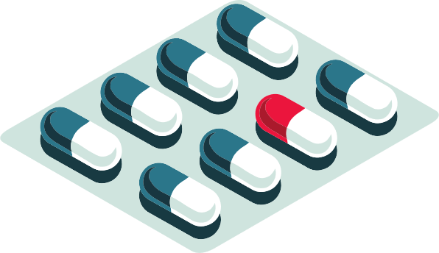


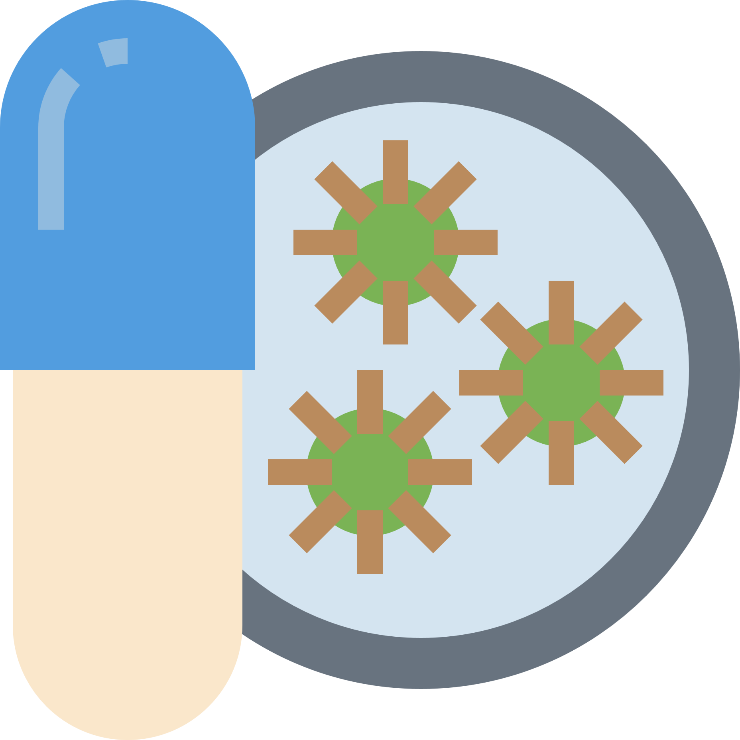


Antibiotics…Is there a problem?
What’s the problem?
Adverse reactions
Microbial resistance (MDROs)
C. difficile
Colonization
Notes:
Script:
You have likely been prescribed an antibiotic to get rid of an infection. And after a few days, that treatment made a difference- you started to feel better and soon you recovered. There is no doubt, treatments such as antibiotics are great and have saved the lives of many people. So what’s the problem? Well you have likely heard that with antimicrobial drugs, which includes antibiotics, there can be too much of a good thing. Sometimes people can have adverse reactions to taking these medications including allergic reactions and even toxic effects. As antimicrobial drugs are used more and more to help us stop infections, the germs that cause infections have developed ways to become resistant to the effect of these medications. And as germs develop these resistant mechanisms, they share this information with other germs through their genetic material so multi-drug resistant organisms (MDROs) are the result. Another negative result of using antibiotics is an increased risk of an infection called C. difficile, or C. diff for short. When we use antibiotics, we may get rid of bad bacteria but also the good bacteria we need. Without the good bacteria, C. diff has an opportunity to establish itself. This infection, which causes diarrhea, fever, loss of appetite, and stomach tenderness, can be severe especially for older people, resulting in hospitalization and even death. Lastly, antibiotic use can lead to becoming colonized with an MDRO like Mrs. Sanchez. While those who are colonized do not have signs and symptoms, if there are any changes in their health status, for example they get sick due to another disease and this affects their immune system, this colonization can become an infection resulting in illness from the MDRO. Both C. diff and MDROs can spread very easily in nursing home communities if the appropriate prevention precautions are not put in place. So you can see, there can be some serious consequences when we use antibiotics and so therefore we need to use them only when needed.

Slide 8




Antimicrobial Use and Misuse
Common Use
Pneumonia
Skin infections
Urinary tract infections
Common Misuse
Overdiagnosis
Over treatment
Notes:
Script:
It is important to stress that antibiotics are important and needed to treat infection commonly seen in nursing homes including pneumonia, skin infections, and urinary tract infections. But unfortunately, at times residents are over diagnosed meaning a healthcare provider believes there is an infection or disease even when a residents has no signs or symptoms at all but, bacteria are found in their bodies, for example bacteria in the urine. This then leads to unnecessarily prescribing antibiotics to a resident. A resident can also be over treated for an infection, meaning antibiotics are prescribed for an infection even when it is not needed. This can be using an inappropriate antibiotic that targets several kinds of bacteria although the resident has very specific bacteria. Or prescribing an antibiotic because the resident or a family member demands an antibiotic even if it may not be needed. Over diagnosis and over treatment are unfortunately common in nursing homes- up to three out of four nursing home residents have been prescribed an antibiotic that is inappropriate or unnecessary.
Know Before You Go!
Common infections in nursing homes was the topic of another ICARE lesson- please review this lesson and the associated materials to learn more.

Slide 9





Antibiotic Stewardship
Goal
Right drug, dose, duration and administration
Minimize consequences
Maximize benefits
Improvement Practices
Leadership, accountability, & expertise
Actions to improve use
Tracking, reporting, & education
Notes:
Script:
In order to address the misuse of antibiotics and other antimicrobial drugs, nursing homes are required to develop an antibiotic stewardship program as part of the nursing home community’s infection prevention and control plan. So what is antibiotic stewardship? The antibiotic stewardship program serves to improve the prescribing of antimicrobial drugs such as antibiotics. The goal is to provide the right drug and dose for the right duration and administered in the right way, so for example orally versus through a person’s veins. This goal helps to minimized the consequences and maximize the benefits when these treatments are needed.
The antibiotic stewardship program work by putting in place important improvement practices. These practices begin with having nursing home leadership committed to antibiotic stewardship for example, by including antibiotic stewardship duties in leadership position description and tasks. Accountability includes having a designated infection preventionist over antibiotic stewardship activities with input from the medical director, director of nursing, or a pharmacist that serves as a consultant to the nursing home. Having access to those with expertise on antibiotics and other antimicrobial drugs such as a consulting pharmacist or an external infectious disease consultant. The actions to improve antibiotic use must include policies and practices that improve antibiotic prescribing. Some actions include requiring those who prescribe antibiotics to clearly document dose, duration, and the reason for antibiotic use for all antibiotic prescriptions. Another important action includes having nursing home specific practices for assessing residents for infections, ordering appropriate laboratory tests for infections, and recommendations for treating infections. Nursing homes must also track how antibiotics are being prescribed and used in the nursing home community and monitor possible common consequences of antibiotic misuse such as rates of MDROs, C. diff or other adverse events. The nursing home must also provide nursing home specific reports on the actions mentioned above to medical and nursing staff especially those who prescribe antibiotics. And lastly, a nursing home should educate staff and residents regarding antibiotic stewardship.
Know Before You Go!
The CMS Surveyor Guide, Appendix PP covers the requirement for the antibiotic stewardship program under Infection Control (§483.80) but is a separate F-tag (F881). Federal surveyors use F tags to document and communicate violations to quality care. Infection prevention covers F880-F888 but antimicrobial stewardship is specifically F tag F881. See the References and resource for CMS documents.
Several great checklists and toolkits are available to help nursing homes to ensure they have meet the regulatory requirements and national standards related to antibiotic stewardship. Below is a list but please see the references for additional details.
CDC, The Core Elements of Antibiotic Stewardship for Nursing Homes (Checklist): https://www.cdc.gov/antibiotic-use/core-elements/pdfs/core-elements-antibiotic-stewardship-checklist-508.pdf
CMS QSO-20-03-NH. November 22, 2019. Attachment A Long-Term Care (LTC) Infection Control Worksheet. Infection Control Self-Assessment tool for nursing homes. https://www.cms.gov/files/document/qso-20-03-nh.pdf
CMS Infection Prevention, Control & Immunization Survey Pathway Checklist- Survey Resources Zip File (Updated 10/26/22). https://www.cms.gov/medicare/provider-enrollment-and-certification/guidanceforlawsandregulations/nursing-homes
AHRQ, Nursing Home Antimicrobial Stewardship Guide, Toolkits: https://www.ahrq.gov/nhguide/toolkits.html
AHRQ, Nursing Home Antimicrobial Stewardship Guide, Implement, Monitor, and Sustain an Antimicrobial Stewardship Program- Two Toolkits: https://www.ahrq.gov/nhguide/toolkits/implement-monitor-sustain-program/index.html

Slide 10

Practices: Protecting Self and Others
Vaccinations- positive impact on your health and those around you!
Influenza, pneumococcal, and COVID-19
Immunization policies and practices
Residents and staff
Offer vaccination
Eligibility and education
Documentation
Administration- accept/refuse exemptions
Other important immunizations!
Notes:
Script:
As you just learned, antimicrobial medications like antibiotics are important as these are medication taken by residents which can affect the health status of other residents. But there is also another very important medical measure that can be take by residents and those closest to them that can impact the health of other residents- vaccinations! Vaccinations can have a positive impact on your health and the health of those around you. It was mentioned previously in this lesson that pneumonia is a common infection see in nursing home residents. When residents get infected with flu, strep bacteria know as pneumococcal bacteria, or COVID-19, these infections can spread to others in the nursing home community and result in pneumonia for some who become infected. Therefore, nursing homes are required to have policies and practices in place for both resident and staff immunizations. Immunization is the practice of giving a vaccination to a person. Keep in mind that nursing homes are only required to have practices and policies in place for staff related to COVID-19 immunization while polices and practices for residents include influenza, pneumococcal bacteria, and COVID-19. Nursing homes must offer certain vaccinations to residents and staff to promote their use.
Nursing homes must screen residents to ensure they are eligible for immunizations. Education regarding the vaccine must be provided to residents and their representatives but also staff regarding the benefits and possible side effects of the vaccine. Nursing homes must document all of their activities related to immunization of residents and staff including when the vaccine was administered and if a resident or their representative decides to accept or refuse the immunization. While the COVID-19 vaccine is required for staff who work in the nursing home, staff also have the right to request an exemption due to medical or religious reasons. Lastly, while nursing homes have requirements for flu, pneumococcal, and COVID-19 vaccines- there are many more important immunizations that are recommended for residents and staff. Please see the information sheet associated with this lesson for more information regarding recommended vaccines.
Know Before You Go!
The CMS Surveyor Guide, Appendix PP covers the requirement for immunizations for influenza and pneumococcal under Infection Control (§483.80) but is a separate F-tag (F883). Federal surveyors use F tags to document and communicate violations to quality care. Infection prevention covers F880-F888 but influenza and pneumococcal immunizations are specifically F tag F883. COVID-19 immunizations for residents and staff are covered under separate F tags (F887 and F888 respectively). Note that COVID-19 vaccinations are discussed in detail in CMS memo QSO-23-02 ALL and not Appendix PP of the CMS surveyors guide. See the References and resource for CMS documents.

Slide 11

Quality Care & Resident Rights
Antibiotics- benefits & consequences
Promote & improve antibiotic use
Important immunizations- residents & staff
Quality
Infection Prevention & Control
Resident Rights
Infection Prevention & Control
Resident
Rights
Informed and Involved
Notes:
Script:
So now that you know antibiotics, their benefits and possible consequences, how nursing homes promote and improve antibiotic use, and important immunizations for both residents and staff - what does that have to do with resident rights and responsibilities?
All residents, those closest to them including the nursing home community’s staff and administration want high quality care and deserve an environment that promotes high quality care - reaching the highest level of quality in a nursing home community includes taking all steps to prevent and control infections. And as all nursing home communities experienced during the COVID-19 pandemic, infections occurring not only inside, but also outside of the nursing home community, can result in changes that impact a resident’s rights such as visitation and freedom to participate in activities. These changes can have a major impact on a resident’s overall well-being.
When nursing home communities work side by side with residents and those closest to them such as family members to prevent and control infections, this demonstrates a commitment to quality care that preserves and promotes resident rights. And when resident rights are protected and preserved, this also strengths a nursing home community’s ability to prevent and control infections resulting in balanced, quality care. When infections are prevented and controlled to delivery high quality care, two major resident rights are protected: being informed and involved.
Know Before You Go!
Federal regulations related to infection prevention (§483.80) establish minimums standards in these areas. See the References and resource for CMS documents.

Slide 12
Resident & Advocate: Rights & Responsibilities
Informed
Antibiotics- dose, duration, use
Vaccinations- benefits and possible side effects
Involved
Care decisions- acceptance and refusal
Infection prevention and control plan & feedback
Notes:
Script:
Residents have the right to be informed about any medications they are being prescribed including antibiotics. This includes the dose, duration, and the reason it is being prescribed. Residents also have the right to receive information regarding the benefits and possible side effects of any vaccinations offered by the nursing home. Residents have the right to be involved in all of their care decision including the decision to accept or refuse any antibiotic or vaccination. Lastly, nursing home residents have a right to be involved in the nursing home community’s infection prevention and control plan. This involvement includes being provided education on infections, how they are prevented and controlled, and what the nursing home is doing to prevent and control infections. Residents have the right to provide feedback to the nursing home leadership regarding care quality concerns and have this feedback result in care quality improvement.
Know Before You Go!
Resident and advocates have rights and responsibilities when it comes to antibiotic stewardship, immunizations, and other care quality related items. Appendix PP of the CMS Surveyor Guidance details resident rights related to quality assurance and process improvement under 483.75, F865-F868. See the Resources and References section for a link to this document

Slide 13
Nursing Home Requirements: Infection Prevention & Control
Infection control policies and procedures based on recognized guidelines
Antibiotic use, monitoring, feedback
Immunization administration, education, documentation
Strong Infection Prevention and Control Program
Federal and State Law Requirements
Notes:
Script:
Quality care can only be achieved when nursing homes have a strong program in place to prevent and control infections. Federal and state laws require nursing homes to have: 1) current infection control policies and procedures that include antibiotic stewardship and immunization programs. 2) written policies for antibiotic use, monitor antibiotic use trends by those who prescribe antibiotics, and system for feedback to those who prescribe antibiotics. Lastly, 3) a nursing home must make certain immunizations available for administration to residents, provide education to residents and their representatives regarding immunizations, and document the education provided and the resident’s decision to accept or refuse vaccination.
Know Before You Go!
Be familiar with the handout entitled “Infection and Control: Regulations and Requirements”; this handout is based on the CMS State Operations Manual Appendix PP- Guidance to Surveyors for Long-Term Care Facilities (Appendix PP). Regulations related to infection prevention & control and standard precautions which include hand hygiene can be found in §483.80 Infection Control. See the References and resource for CMS documents.

Slide 14



Ms. Johnson and Mrs. Sanchez
Informed
Antibiotic stewardship
Vaccinations
Involved
Infection assessment
Infection prevention and control plan
Notes:
Script:
Going back to Ms. Johnson and Mrs. Sanchez, they ask Mr. Moore, the resident council president, to add antibiotic misuse as a topic for the next resident council meeting. Susanna, Springville Nursing Home’s part-time pharmacist and infection preventionist is invited to the meeting. Susanna ensures residents are informed about the antibiotic stewardship program by discussing the basics regarding the program, providing handouts, and putting up posters throughout the facility. Susanna also informs residents about the vaccinations they are recommended to be up to date on using an easy to use chart. Susanna also asks residents to be involved in their care- to ask providers regarding antibiotics- when they should be used or if they should be discontinued or adjusted. To help residents understand what questions to ask their providers, Susanna uses an infection assessment tool to go over common infection signs and symptoms as well as common laboratory tests and results. Ms. Johnson continues to be very impressed with how The Springville Nursing Home works with residents to prevent and control infections! She asks Susanna if she can be more involved in the infection prevention and control plan. Specifically how she can help her friend, Mrs. Sanchez, who was recently diagnosed with dementia, and other resident with dementia, apply infection prevention and control measures. She knows with their condition, it can be very difficult to practice infection prevention measures consistently. Susanna is very excited and welcomes Ms. Johnson’s input. To get more involvement, Susanna starts a special sub-committee of the quality assessment and assurance committee with residents and family members to provide input on how to better communicate and apply infection prevention to those with dementia. This is a great process improvement project for the Springville nursing home!

Slide 15
Discussion
Do you have concerns about antibiotics and their use?
Have you heard of antibiotic stewardship measures used in this facility?
Do you have any concerns regarding vaccines? If so, has this facility addressed your concerns?
Do you feel residents or their families can put pressure on providers to prescribe antibiotics? How can you help providers with antibiotic stewardship?
Notes:
Script:
Now that we covered this lesson on antibiotics and vaccines let’s talk a little bit about what we learned. (read selected discussion points)
Ombudsman Notes:
Discussion & Advocacy Points- After watching this lesson or having residents/family members watch the lesson, consider the questions below to reinforce learning and promote discussion. Feel free to edit this slide to use one or more questions:
Do you have concerns about antibiotics?
The purpose of this question is to have participants reflect on both the benefits and possible consequences of antibiotics- reflecting on what they learned in the lesson.
Do you have any concerns regarding vaccines? If so, has this facility addressed your concerns?
The purpose of this question is to have participants openly discuss concerns regarding vaccines and why the concerns exist. This question also provides information regarding how the facility can better address specific concerns regarding vaccines.
Do you feel residents their family members can put pressure on providers to prescribe antibiotics? How can you help providers with antibiotic stewardship?
The purpose of this question is to have participants reflect on the active role they can plan in promoting antibiotic stewardship.

Slide 16
Advocacy: Next Steps
Education
Nursing home specific risk assessment
Nursing home specific policies and procedures
Engagement
Resident or family council to review policies and monitoring
Empowerment
Quality assurance and assessment committee (QAA committee)
Resident and/or family member role in monitoring
Notes:
Script:
So what are the next steps you can take to receive the highest quality of care and preserve your rights?
Ombudsman Notes:
After the discussion be sure to emphasize at least one next step residents and family members can take receive high quality care and preserve their rights. How can you assist and provide follow-up for this step?
Recall that in the ICARE program, participants move in small, realistic steps:
1) Education (defining and understanding infection prevention and quality care)
2) Engagement (begin incorporating direct interaction with nursing home leadership and staff on infection prevention quality measures)
3) Empowerment (motivate and support participants to take an active role in improving quality care through infection prevention related quality improvement project or other quality care initiatives)
Feel free to edit this slide to use one or more advocacy steps. It is very important to stress the role of the QAA (or the name of the committee commonly used in your state) as most residents and family members are unaware of this committee. Advocacy next steps may include:
Ask the facility if they have conducted a facility risk assessment and review with residents and family members. An assessment should include antibiotic use and multi-drug resistant organisms. There are several tools available online from governmental and non-for profit agencies to see what should be in a risk assessment:
CMS, Quality Improvement Organizations, Facility Assessment Tool: https://qioprogram.org/facility-assessment-tool
Leading Age, Facility Assessment Template: https://leadingageil.org/resources/3%20Facility%20Assessment%20Template%20with%20Instructions.pdf
Note this facility specific risk assessment is broader and encompasses infection control. As part of this broad risk assessment, an infection prevention and control assessment using the CDC ICAR tool should also be done: https://www.cdc.gov/infectioncontrol/pdf/icar/nursing-home-icar-facilitator-guide.pdf
Ask the facility for their infection control policies and procedures related to antibiotic stewardship and immunizations as well as any tools used for monitoring.
Suggest forming a resident or family council if not currently in place and having the nursing home administrator or other staff member review and discuss the facility risk assessment, infection prevention policies and procedures, and monitoring antibiotic use.
Have a member of the QAA committee discuss corrective action steps taken with any monitoring data and what the residents and family members can do to assist in this process. For example, can they provide feedback using a survey or tool? Or to be involved in a process improvement project

Slide 17
This project is supported by the Health Resources and Services Administration (HRSA) of the U.S. Department of Health and Human Services (HHS) under grant number U1QHP28735. Its contents are solely the responsibility of the authors and do not necessarily represent the official view of the Health Resources and Services Administration or the U.S. Department of Health and Human Services.
https://www.unthsc.edu/ICARE
ICARE
Infection Control Advocate & Resident Education
Notes:
Script:
Thank you for watching this lesson, please see the ICARE website for additional lessons, information, and support.
References & Resource:
Infection Prevention Guide to Long-Term Care, 2nd Edition. Chapter 4: Antimicrobial Stewardship. Association for Professionals in Infection Control and Epidemiology; 2019. Arlington, VA
CDC, Core Elements for Antimicrobial Stewardship for Nursing Homes. https://www.cdc.gov/antibiotic-use/core-elements/nursing-homes.html.
The Agency for Healthcare Research and Quality’s “Nursing Home Antimicrobial Stewardship Guide” http://www.ahrq.gov/nhguide/index.html for examples of antibiotic use protocols, policies and practices.
CMS QSO-20-03-NH. November 22, 2019. Attachment A Long-Term Care (LTC) Infection Control Worksheet. Infection Control Self-Assessment tool for nursing homes. https://www.cms.gov/files/document/qso-20-03-nh.pdf
CMS Appendix PP Guidance to Surveyor for Long-Term Care Facilities: 483.10- Resident Rights (F550- Resident Rights; F584- Safe/Clean/Comfortable/Homelike Environment); 483.75- QAPI; 483.80- Infection Control (F880 Infection Control); https://www.cms.gov/files/document/appendix-pp-guidance-surveyor-long-term-care-facilities.pdf
CMS Infection Prevention, Control & Immunization Survey Pathway Checklist- Survey Resources Zip File (Updated 10/26/22). https://www.cms.gov/medicare/provider-enrollment-and-certification/guidanceforlawsandregulations/nursing-homes
CMS Memo QSO23-02 ALL. Revised Guidance for Staff Vaccination Requirements. https://www.cms.gov/files/document/qs0-23-02-all.pdf. Released 10/26/22.

