Slide 1

This project is supported by the Health Resources and Services Administration (HRSA) of the U.S. Department of Health and Human Services (HHS) under grant number U1QHP28735. Its contents are solely the responsibility of the authors and do not necessarily represent the official view of the Health Resources and Services Administration or the U.S. Department of Health and Human Services.
ICARE
Infection Control Advocate & Resident Education
Notes:
Script
Welcome to ICARE- Infection Control Advocate and Resident Education

Slide 2
Infection Control Advocate and Resident Education
Safeguarding the Nursing Home Environment
Notes:
Script:
In this lesson, we will cover safeguarding the nursing home environment
Ombudsman Notes:
Lesson Main Messages:
The nursing home community is a unique place where microbes survive and thrive due to the people, pathogens, and practices
Nursing home environments can be a safe and clean by having clear and documented practices for cleaning, disinfection, and sterilization that are routinely monitored for quality practice
Residents rights are protected when they are informed about the nursing home policies and practices related to cleaning and disinfection and are involved in education to help them better understand cleaning, disinfection, and the role everyone plays in safeguarding the nursing home environment.
Lesson Materials:
Link to online lesson: https://rise.articulate.com/share/LO6dLhRqF_-6bwSJYktyC8nCqPUuUzxS
Handout- ICARE: Keeping the Nursing Home Environment Safe
Handout- Safeguarding the Nursing Home Environment: The Ombudsman’s Role
Additional handouts can include:
Preserve My Rights, Prevent Infections!
Infection Prevention and Control: Regulations & Requirements
Resident Care Roles: Nutrition & Environmental Services
Total Teach Time: ~30 minutes
Lesson video run time: 20 minutes
Discussion & Advocacy: ~5-10 minutes
Post lesson survey: 5 minutes (Survey link: https://unthsc.qualtrics.com/jfe/form/SV_0GPMUr0cEq2BBAy)

Slide 3


A fall morning at the Springville Nursing Home...
Notes:
Script:
(ADVANCE) We once again return to the Springville Nursing home- on a beautiful fall morning.

Slide 4




Learning Together…
Common infections
Germs spread
Prevent spread
Notes:
Script:
Stella Johnson has been working with her family members (ADVANCE) as well as other residents and their families (ADVANCE) to better understand: (ADVANCE) common infections in nursing home residents, (ADVANCE) how germs that cause common infections spread in nursing homes, and (ADVANCE) how to prevent and control the spread of germs. This information was presented at resident and family council meetings and while everyone learned a lot, some questions have come up as well.

Slide 5


Working Together…
Do certain germs spread more easily in nursing homes?
What is being done to keep the nursing home environment safe?
Notes:
Script:
After a resident council meeting discussing an increase in antibiotic resistant bacterial infections in the nursing home, Ms. Johnson and Mr. Moore, another resident at the Springville Nursing Home and the president of the resident council, wonder: (ADVANCE): Do certain germs spread more easily in nursing homes? And what is being done to keep their nursing home environment safe?

Slide 6
What Will I Learn?
  Why do certain germs spread more easily in nursing home communities?
  What steps can be taken in the nursing home environment to stop the spread of infections?
  How can being informed and involved respect resident rights while preventing and controlling infections?
Notes:
Script:
After this lesson, you will be able to answer the following questions:
(ADVANCE) Why do certain germs spread easily in nursing home communities?
(ADVANCE) What steps can be taken in the nursing home environment to stop the spread of infections? Lastly,
(ADVANCE) How can being informed and involved respect resident rights while preventing and controlling infections?

Slide 7
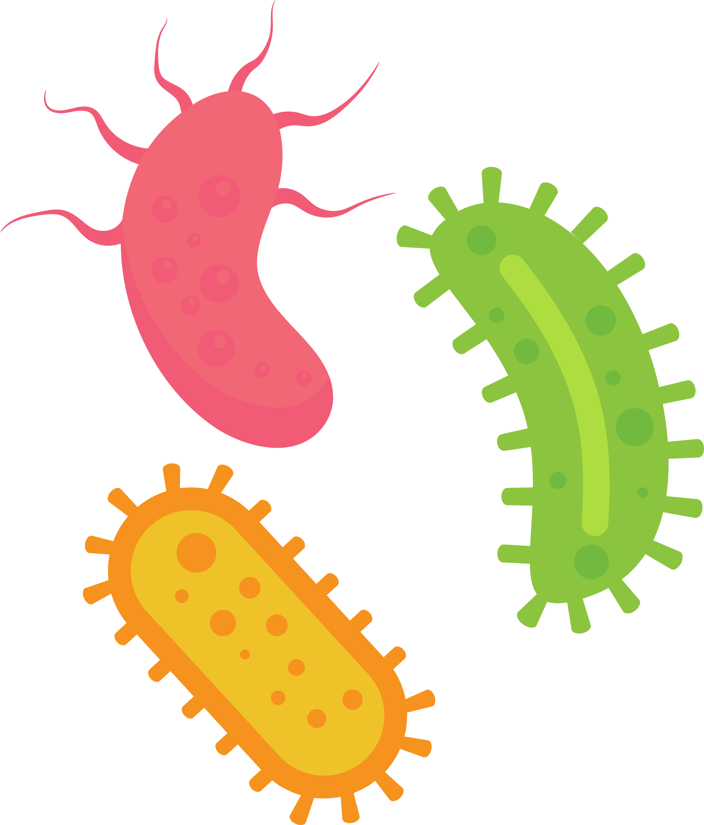

Germs and the Environment
  Susceptible people
  Shared spaces, shared germs
  Home, not a hospital
  Products and practices
  Hardy and resistant germs
All of the above!
Notes:
Script:
A nursing home (ADVANCE) can be a great place where people live and work but it can also be a place where (ADVANCE) germs, especially germs that are resistant to certain medications and chemicals, can survive and thrive. But why? Well people in nursing home communities, (ADVANCE) due their age and health, can more easily get an infection and become sick- so they are more susceptible to getting germs. And many times (ADVANCE) people who are vulnerable to getting an infection (susceptible) share tight spaces, and sharing tight spaces also means sharing germs. But in addition to shared spaces, it’s the kinds of spaces that are found in a nursing home community. The nursing community is a home, and not a hospital like environment. Nursing homes are required to provide a clean, safe environment that is “homelike”- one where residents use their own personal items, so they feel at home and can express themselves. This can include having, for example, a soft chair a resident likes, curtains, and drapes. All of these items, while the do make a place feel like home, they can be harder to clean and remove germs from. This brings us to the very important role of products and practices. (ADVANCE) The kinds of products used to get rid of germs and how these products are used is also very important. The right chemical products must be used on the right surfaces and for the right amount of time to work correctly. If this is not done, then germs can continue to survive and thrive. And Lastly, germs themselves have developed ways to be hardy and resistant, so they are not easy to kill and get rid of in a nursing home environment. Of course, a combination of all of the above can allow germs to survive and thrive in a nursing home community.
Know Before You Go!
As noted in lesson 1, nursing home residents are susceptible to not only infection but also severe disease due to infection. This is due to two main factors:
1) Resident-specific factors (age, chronic diseases, disability, and specific procedures and treatments); and 2) environmental factors (congregate living and healthcare transitions).
Nursing home residents are susceptible to not only infection but also severe disease due to infection. This is due to two main factors:
1) Host (resident)-specific factors: age, chronic diseases, disability, and specific procedures and treatments.
As people age, their immune systems do not function as well and may not be able to fight off an infection as easily. This is called immunosensence.
Common chronic diseases that can lead to increased infections in older adults include cardiovascular disease, cancer, diabetes, chronic obstructive pulmonary disease (COPD), and arthritis. These diseases, directly or indirectly, may lead to increased infections by affecting how the body can utilize nutrients and oxygen or how a person ambulates or moves to prevent the breakdown of skin or tissues.
Cardiovascular disease affects the heart and blood vessels. Common cardiovascular diseases include congestive heart failure (inability of the heart to pump blood efficiently) and myocardial infarction (heart attacks).
Cancer is when the body’s cells grow uncontrollably and spread to other parts of the body. One in three cancers is diagnosed after the age of 75.
Diabetes includes type I and type II diabetes, both of which keep your body from regulating blood sugar with the help of a hormone called insulin. Type I diabetes initially occurs when a person is young, due to genetic reasons; with type I diabetes, a person does not make enough insulin to regulate blood sugar. Type II diabetes occurs much later in life and is caused by diet and lifestyle. With type II diabetes, people can no longer use insulin effectively to regulate blood sugar. The risk of type II diabetes increases with age.
COPD includes emphysema and chronic bronchitis. Emphysema is the destruction of the air sacs of the lungs and is primarily associated with a history of smoking tobacco. Chronic bronchitis is the inflammation of the airways of the lungs and is typically caused by long periods of exposure to pollutants.
Arthritis, specifically osteoarthritis, occurs over time from use, with the bones becoming damaged.
Disability is the effect of chronic diseases and conditions on a person’s ability to engage in the activities of daily living (ADLs). ADLs are basic self-care tasks such as walking, eating, bathing, toileting, and dressing. Arthritis and cardiovascular disease are common predictors of disability.
A common invasive device in nursing home residents is a urinary catheter (a flexible tube inserted into the bladder to empty the bladder). Common treatments in nursing home residents include antibiotics, which, if not used correctly or when needed, can make a person more susceptible to infection and illness.
2) Environmental factors: congregate living (shared housing and social activities) and healthcare transitions (moving to a different facility or location or a different level of care).
Congregate living increases the probability of coming into contact with multiple people who may be able to transmit infections.
Healthcare transitions can result in medical errors, inappropriate care, and poor clinical outcomes. All of these may increase opportunities for the transmission of infection.
Home Environment: The nursing home is a unique, healthcare environment that must balance the requirements of healthcare level cleaning and disinfection, with a “homelike” environment.
Per CMS regulation (483.10i), nursing homes must provide “a safe, clean, comfortable, and homelike environment..” This includes allowing residents to use their own personal items as much as possible, and gives the resident opportunities for self expression, provide homelike furniture and items like drapes and curtains, furniture that is comfortable, and promptly address any cleaning needs. CMS emphases the need to avoid an “institutional” practices that may feel more like hospitals.
These personal items may be difficult to clean and disinfect, as well as track cleaning and disinfection. But, the facility must have a procedure and processes in place to address cleaning and disinfection in this “homelike” environment.
Products and Practices: Only specific, EPA registered products should be utilized to ensure thorough cleaning and disinfection
Nursing homes are required by CMS regulations to use EPA registered, healthcare or hospital grade products and cannot use, common household grade disinfectants that are not EPA registered. But using the right product is just the first step. The right product must be used on the appropriate surface, for the right amount of time and that surface must be cleaned before disinfected.
Some products can be used to clean and disinfect while others are for disinfection only. Cleaning is removing visible soil material from objects and surfaces by scrubbing for example, using some type of detergent or enzyme product. Disinfection is destroying most microorganisms but not all like those that are resistant due to their form (like a spore- a highly resistant outer structure; resistant to many disinfectants, drying, and heat).
Hardy and resistant germs: microorganism have physical and genetic advantages that allow them to bypass harsh environments, including drying, heat, and antibiotics.
Bacteria can have a thick wall that allows them to survive for longer in the environment (gram-positive bacteria) or have a membrane that keeps chemicals like antibiotics out, making them resistant to these antibiotics (gram-negative bacteria).
Some bacteria can use structures called spores, so they become inactivated and in a dormant form. In this spore form, bacteria are resistant to heat, drying, and some commonly used chemicals. A common spore-forming bacteria is C. diff.
Another structure used is a capsule that allows bacteria to stick to people more easily but also guards it from being destroyed.
Bacteria can also use biofilms, which are mesh-like structures where large groups of bacteria communicate and are protected from the environment. These biofilms are very difficult to get rid of.
Viruses that do not have a lipid outer layer and are small, like norovirus, are also more hardy in the environment, lasting for longer periods, and cannot be killed with an alcohol-based hand rub.

Slide 8
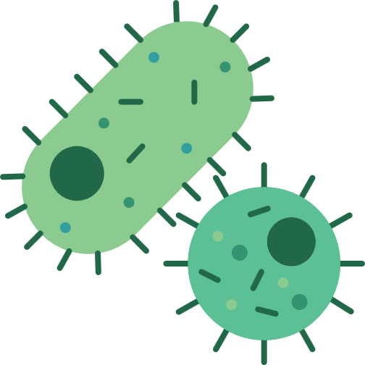

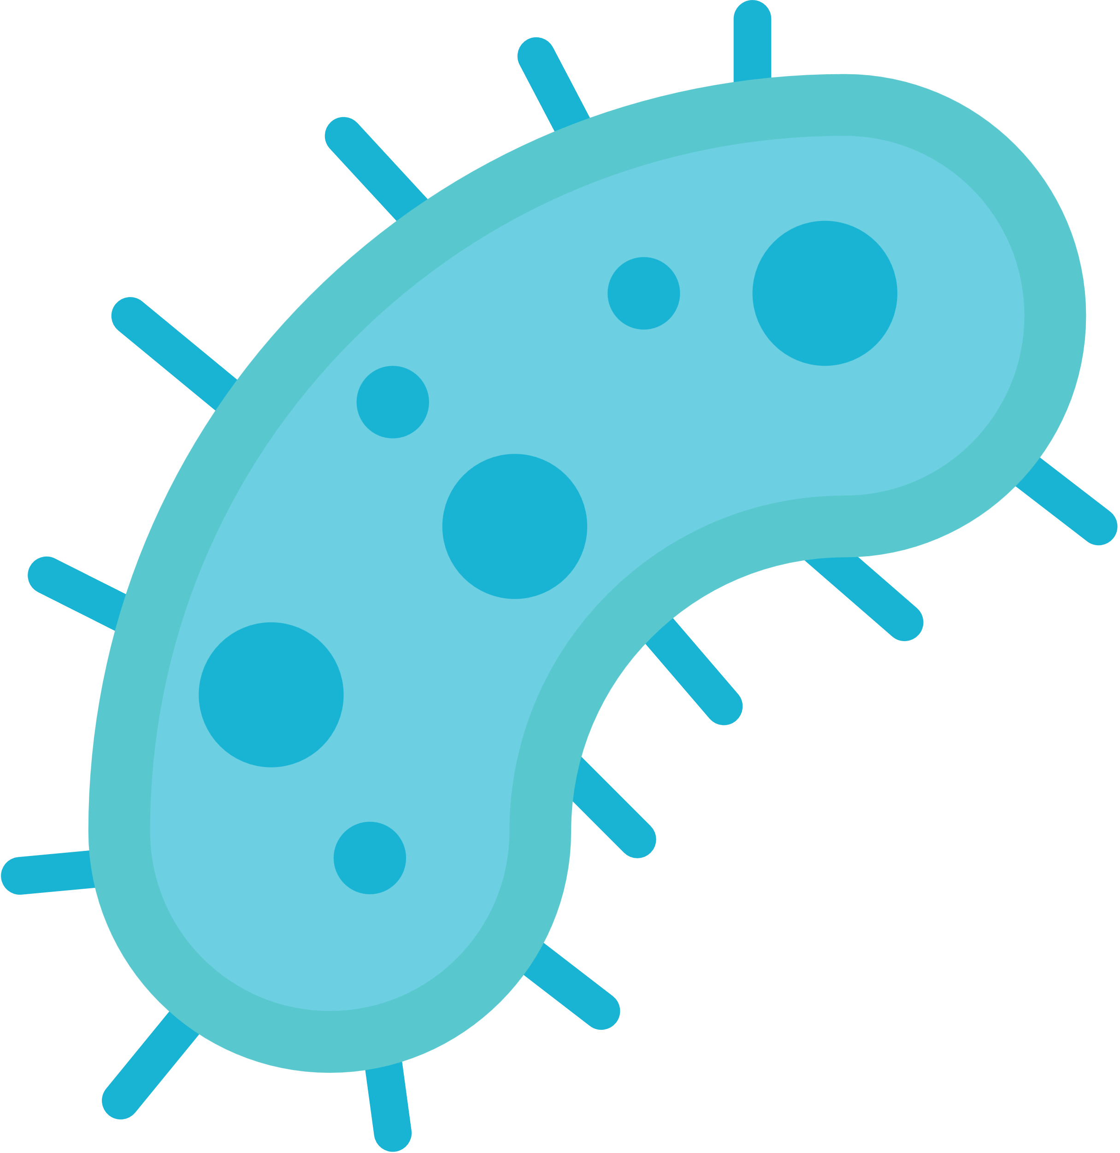
Unique and Tough Germs
Adapt
Survive
Resist
  Perfect people, places, and practices for pathogens!
    Adapt to conditions
    Survive on surfaces for long periods
    Multi-drug resistant organisms (MDROs)
Notes:
Script:
So, because of all of the things just mentioned- (ADVANCE) perfect people, places, practices- pathogens (which are bad germs that make us sick) are more commonly found in nursing home communities. These unique and tough germs have adapted (ADVANCE) to be hardy and take advantage of the nursing home environment and the people there- spreading easily in tight spaces. These germs can survive (ADVANCE) on surfaces for long-periods of time- From hours, to weeks, to months! These germs also communicate with each other, passing along the genes needed to make them resistant to several antibiotics, so they are called multi-drug resistant organisms (MDROs) (ADVANCE) . So it is the right conditions that keep these bad bugs in nursing home communities. To learn more about the different types of germs commonly found in nursing homes, please see the information sheets in this lesson.
Know Before You Go!
Perfect people (susceptible residents), places (close, communal spaces), and practices (cleaning and disinfection) for the right pathogens (general term for microorganisms that make people sick)
As previously mentioned, many residents may have chronic conditions that require medications and treatments that can lead to infections. Inappropriate use of antibiotics and invasive procedures such as urinary catheters are unfortunately common in nursing homes. 40 to 75% of antibiotics prescribed in nursing homes may be unnecessary or inappropriate, with the most common use of inappropriate therapy being a suspected urinary tract infection (APIC Text). This inappropriate antibiotic use leads to the proliferation of drug-resistant microbes.
Resistance to antibiotics leaves fewer treatment options and can result in negative health outcomes for the resident if the infection cannot be controlled with antibiotics, including death.
Adapt to conditions
(See the previous slide for more information on Gram-negative and Gram-positive bacteria, spores, capsules, biofilms, and viral adaptation for survival)
Survival on surfaces for long periods
CMS Appendix PP provides the example of the following microorganisms on inanimate surfaces: C. diff spores (up to 5 months), Hepatitis B (1 week), and influenza virus (8 hours). See the reference for “Environmental Cleaning and Disinfection: Principles of Infection Transmission and the Role of the Environment” for more survival time and microorganism survival.
Multi-Drug Resistant Organisms (MDROs)
Studies have shown that MDROs are a major issue for nursing home residents because:
More than ½ of nursing home residents have been shown to be colonized (have bacteria on them without causing illness) with MDRO.
MDROs have caused outbreaks in nursing homes.
If a nursing home resident gets sick due to an MDRO, there are limited treatment options.
See the CDC document “Implementation of Personal Protective Equipment (PPE) Use in Nursing Homes to Prevent Spread of Multi-drug-resistant Organisms (MDROs)” in the references for a list of MDROs that are considered to pose a risk for nursing home residents.
For more information on the different types and specific microorganisms found in.

Slide 9
Germ Spread (Transmission)
Direct
Contact
  Hugs, kisses, hands
Large drops
  Coughs & sneezes
Indirect
Objects in our environment
  Objects to hands to our eyes, nose, mouth, broken skin
Air
  Very, very small droplets carrying germs long distances and time
Indirect
Objects in our environment
  Objects to hands to our eyes, nose, mouth, broken skin
Air
  Very, very small droplets carrying germs long distances and time
Notes:
Script:
So we know that certain germs can spread more easily in a nursing home community. But how are they spread? Well germ spread, also known as transmission, happens in two ways: directly (ADVANCE) and indirectly (ADVANCE). Germs spread directly from a person to another person through (ADVANCE) contact with them like hugging or kissing. Direct spread also happens when a person coughs or sneezes very close to you and large drops containing germs from their coughs or sneezes directly enter your body. Germs spread indirectly when (ADVANCE) objects and surfaces in our environment get contaminated with germs, we touch those objects or surfaces, and then touch our eyes, nose, mouth, or other areas where germs can get into our bodies like broken skin such as a cut or wound. Some germs also spread indirectly in the air through (ADVANCE) very, very small droplets that can come from people when then talk, sneeze or cough or even spread through using certain medical devices like ventilators. Of course when germs spread to us, we can get an infection and get sick.
In this lesson, we will focus on (ADVANCE) indirect spread from objects and surfaces and what can be done to protect the nursing home environment. Please see the ICARE resources provided in this lesson to learn more about direct germ spread and how to prevent it.
Know Before You Go!
Direct spread (transmission) can be prevented through hand hygiene, personal protective equipment (PPE) and other facility measures. Please see lessons 4: Hand Hygiene Heroes and 5: Gowns, Gloves, and Goggles…Protection for Prevention
Indirect spread (transmission) occurs via three main mechanisms: vehicle transmission, vector transmission, and airborne transmission.
Vector transmission includes spread that occurs through insects such as mosquitoes and flies. As microorganisms that utilize mosquitoes as vectors also have part of their lifecycle in the insect, these vectors are known as biological vectors. For vectors that only physically carry microorganisms indirectly to a person, for example, carrying bacteria on the legs of a fly to contaminate food, these vectors are referred to as mechanical vectors. Microorganisms do not have part of their lifecycle on these vectors.
For this lesson, we will not cover indirect or vector transmission, but note that it is a mechanism for indirect transmission.
Vehicle transmission: inanimate objects, also known as fomites. Typically, replication of the microorganism is limited in fomites but can serve as a source of infection in nursing homes due to factors highlighted in the previous slide.
Airborne transmission occurs when very, very small droplets, called droplet nuclei, and aerosols are able to harbor microorganisms and, due to their extremely small size, remain suspended in the air for extended periods of time (up to hours). Airborne transmission can also occur when microorganisms are carried and suspended in the air through dues. It is important to keep in mind that a microorganism may be primarily transmitted through direct, large droplet spread but may also be transmitted through indirect, airborne transmission. The virus that causes COVID-19 (SARS-CoV-2) is an example of such a microorganism. While SARS-CoV-2 is primarily transmitted directly from one person to another through coughs and sneezes, it can also be transmitted indirectly when certain medical procedures are done that can generate very small droplet nuclei. These procedures are called aerosol-generating procedures, or AGPs, and include ventilation like bilevel positive airway pressure (BiPAP) and continuous positive airway pressure (CPAP). BiPAP and CPAP machines may be used for residents with sleep apnea or chronic obstructive pulmonary disorder (COPD). Therefore, it is important to keep in mind the types of procedures a resident may utilize to determine the possible ways microorganisms can be spread and the best prevention practices.

Slide 10
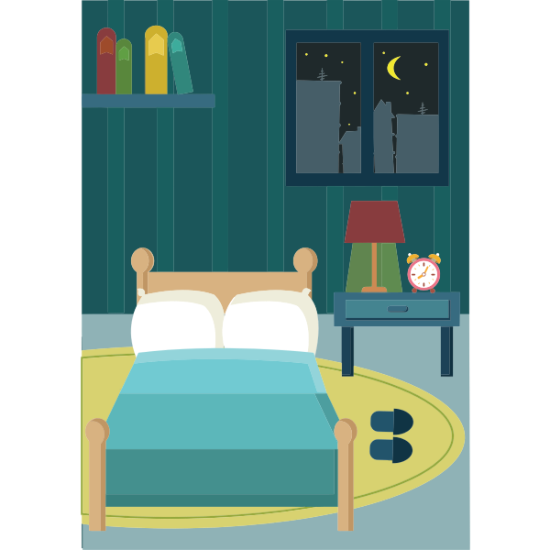
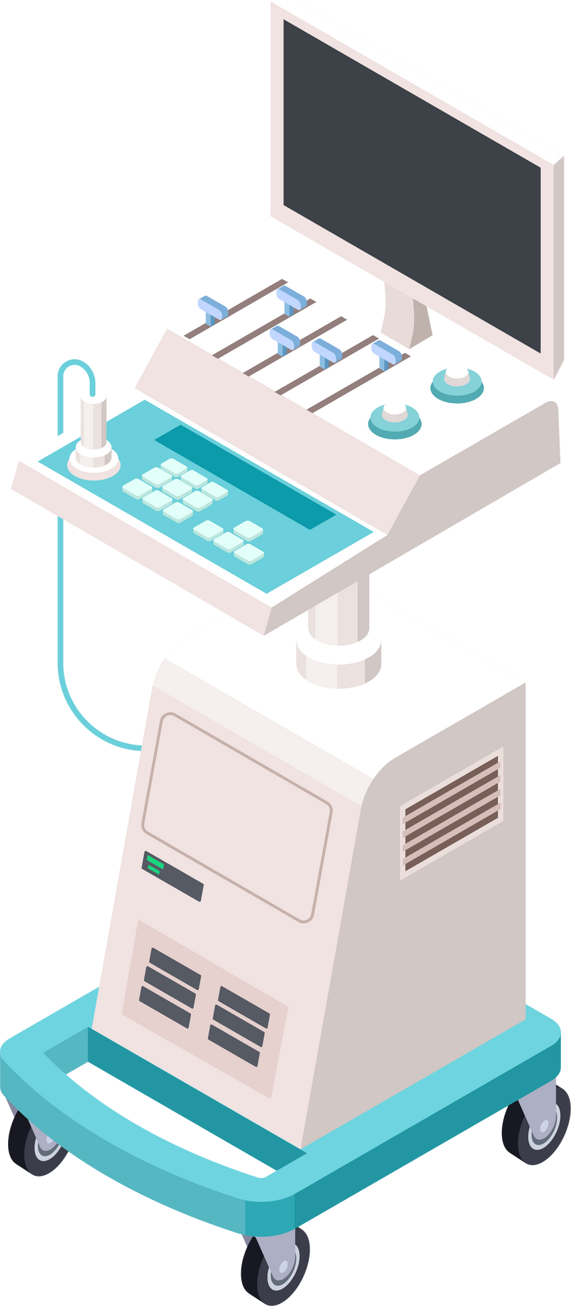


Indirect Spread: Nursing Home Environment
Care Equipment
Household Surfaces
Notes:
Script:
Again, indirect spread occurs from touching contaminated object or surfaces and then (ADVANCE) touching our eyes, nose, mouth, or other areas where germs can get into our bodies like a wound. When we think about the surfaces that can be contaminated with germs then spread indirectly to a person, (ADVANCE) it is important to think of the nursing home community as having two main types: (ADVANCE) surfaces on equipment used for the care of a resident and (ADVANCE) general household surfaces. These two types of surfaces can differ in the way they contribute to germ spread.

Slide 11
Indirect Spread: Nursing Home Environment
  Blood pressure cuffs
  Stethoscopes
  Mobile monitors/Med carts
  Therapy equipment
  Lots of contact!!
  Minimal Touch
    Floors
    Ceilings
  Frequent Touch
    Doorknobs
    Call lights
    Bedrails
  Laundry
Notes:
Script:
Resident care equipment (ADVANCE) includes items such as blood pressure cuffs, (ADVANCE) stethoscopes, (ADVANCE) mobile monitors and medication carts, (ADVANCE) as well as therapy equipment like wheelchairs and walkers. (ADVANCE) These surfaces are usually touched by many people throughout the day and so(ADVANCE) there are many opportunities for germ spread. Household surfaces (ADVANCE) include those that are not touched often (ADVANCE) such as ceilings (ADVANCE) and floors (ADVANCE) so germ spread from these surfaces while possible, may be more limited. But household objects and surfaces that are touched frequently (ADVANCE) such as doorknobs, (ADVANCE) call lights, (ADVANCE) and bed rails (ADVANCE) can easily contribute to germ spread. Another general household item to be aware of is laundry. Laundry (ADVANCE) such as soiled clothing and bed sheets can also easily spread germs and must be handled, stored, processed, and transported in a manner to prevent germ spread.
Know Before you Go!
CMS has very specific requirements related to laundry as laundry contaminated with blood or body fluids can contribute to the transmission of germs.
Laundry is covered under F tag 880 Infection Control §483.80(e)-Linens of the Code of Federal Regulations (CFR). Under CFR §483.80(e). Per this regulation and as detailed the CMS Appendix PP of the Surveyors Guide for Nursing homes, the following must be done by facilities:
There must be written policies and procedures related to the storage, handling, and processing of laundry and linens to prevent the spread of infections.
Laundry includes residents’ personal clothing, linens such as sheets, blankets, and pillows, towels, washcloths, and any other laundry items used in all areas of the facility, such as dietary services and rehabilitation services.
Laundry services can be provided onsite or offsite if there is a written agreement for those services. Regardless of where the laundering processing occurs, it is the facility’s responsibility to ensure laundry is handled, stored, processed, and transported safely and in a sanitary manner.
Laundry handling should be handled as potentially contaminated, so standard precautions such as gloves and gowns could be used. Laundry should not be sorted and rinsed in any open resident care spaces, such as hallways, or where they are being used. Any contaminated laundry must be contained in a leak-proof container or bag and handled to avoid contamination of air, surfaces, and people by minimizing agitation.
Laundry must be handled to prevent cross-contamination.
Clean linens must be stored separately from contaminated linens.
Laundry processing includes using the correct products and temperatures. Please see the CMS Appendix PP for Surveyors for more information.

Slide 12

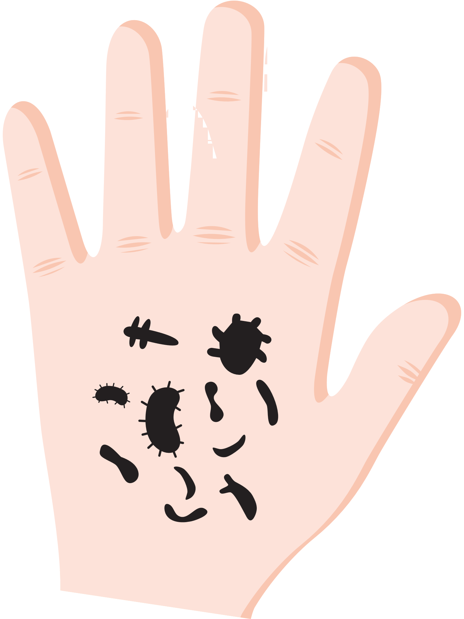
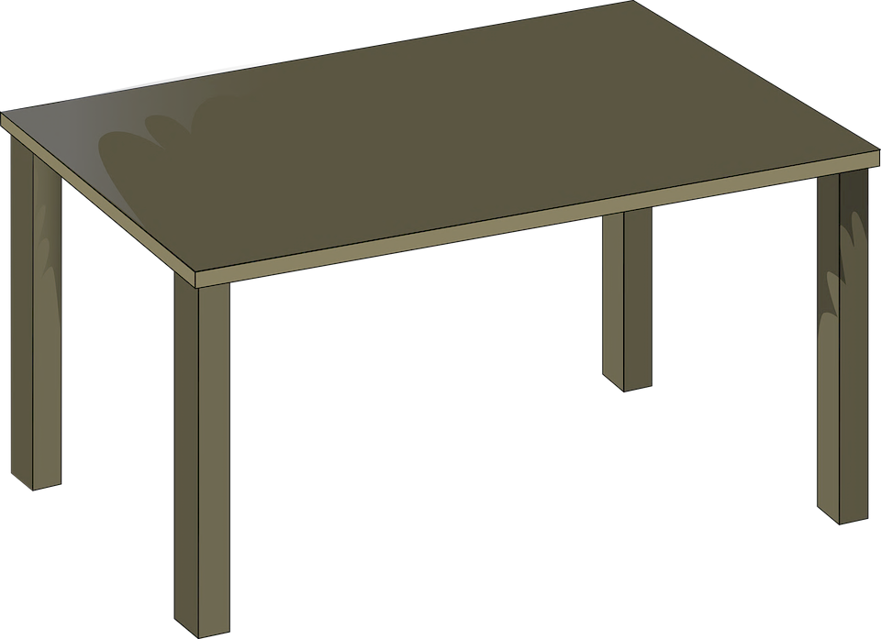




Safeguarding the Nursing Home Environment
Sterilization
Disinfection
Cleaning
Sterilization
Disinfection
Cleaning
Sterilization
Disinfection
Cleaning
Notes:
Script:
So we now know germs that contaminate objects (ADVANCE) and surfaces can get on our hands (ADVANCE) and then inside our bodies which can then lead to an infection and make us sick (ADVANCE). But what can we do to safeguard the nursing home environment from these germs to protect residents, visitors, and staff? It all begins with cleaning, (ADVANCE) which is the foundation for additional steps in safeguarding the nursing home environment. Surfaces and objects in a nursing home community must be cleaned, to then be properly disinfected, (ADVANCE) and for some special object, they must also be sterilized (ADVANCE) to help prevent the spread of germs. The level required, cleaning to disinfection, or sterilization depends on the type of contact we will have with the object or surface.

Slide 13

Cleaning
  All items in nursing home community!!
  Soap or detergent, water, and friction
  Some germ removal
  Removes dirt and debris for disinfection
  Does NOT mean germs killed or surface is free of all germs
Sterilization
Disinfection
Cleaning
Notes:
Script:
Let’s start with cleaning. (ADVANCE) Of course cleaning should be done on (ADVANCE) all objects and surfaces in a nursing home environment! You have likely cleaned several surfaces and objects and know its an important step in removing visible dirt and debris. As you know, cleaning requires using some kind of (ADVANCE) soap or detergent with water, along with scrubbing. Cleaning may remove (ADVANCE) some germs and it also (ADVANCE) removes dirt and debris from surfaces and objects that contain germs and which can prevent disinfectants from working properly. A very important point is that cleaning a surface or object (ADVANCE) does not mean germs have been complete removed or killed.
Know Before You Go!
CMS stresses the that nursing facilities should create a “homelike” environment and must promptly address cleaning needs. Creating an homelike environment includes the requirement to allow residents to use personal belongs including furnishing and as other items determined by the resident to create a homelike environment.
Cleaning is defined by CMS as “removal of visible soil (e.g. organic and inorganic material) from objects and surfaces and is normally accomplished manually or mechanically using water with detergents or enzymatic products”.
Environmental cleaning and disinfection is one element in standard precautions to prevent infections in all residents, staff, and visitors regardless of suspected or confirmed diagnosis or presumed infection status.
Standard precautions are based on the idea that all blood, body fluids, secretions, and excretions (with the exception of sweat), regardless of whether they contain visible blood, non-intact skin, or mucous membranes (nose, mouth), may have microorganisms that can be spread (transmitted).
Other standard precautions include hand hygiene, safe injection practices, selecting the correct personal protective equipment, respiratory hygiene and etiquette, and reprocessing reusable resident medical equipment. Hand hygiene is the focus of ICARE module 4, and standard versus transmission-based precautions are the focus of ICARE module 5.
See the CMS Appendix PP Guidance to Surveyors for Long-term Care Facilities in the references section for additional information.

Slide 14
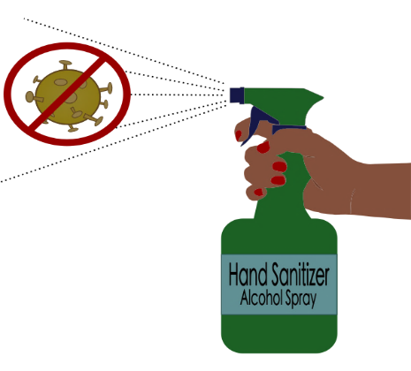
Disinfection
Sterilization
Disinfection
Cleaning
  All resident care & frequently touched items!
  Disinfectants
    Different types/strength levels (low, intermediate, high)
  Destroys most germs
  Does NOT mean surface is free of all germs
Notes:
Script:
After a surface or object is clean, the next step is disinfection (ADVANCE). Cleaning, followed by disinfection should be done on (ADVANCE) all resident care items as well as frequently touched surfaces or objects in the nursing home. Disinfection is typically done by using a special chemical product, known as a disinfectant, (ADVANCE) that destroys most germs. It is important to know that surfaces or objects used in resident care may required (ADVANCE) different types or strengths of disinfectants depending on what area of a person’s body that object or surface may come into contact with. For example, a blood pressure cuff that comes into contact with your intact skin, meaning it does not have a cut or other wound, requires a low or intermediate level disinfectant. But, a surface or object that may come into contact with your mouth like dental equipment or with your skin when it has a cut, no matter how small, like equipment used in foot care, requires a high level disinfectant. Again, disinfection (ADVANCE) kills most germ but does (ADVANCE) not kill all germs especially hardy forms of certain germs.
Know Before You Go!
CMS defines disinfection as “thermal or chemical destruction of pathogenic and other types of microorganisms. Disinfection is less lethal than sterilization because it destroys most recognized pathogenic microorganism but not necessarily all microbial forms (e.g. bacterial spores).
Disinfection is again part of standard precautions to prevent indirect transmission of microorganisms. CMS does state that facility must prevent infections through indirect contact through decontamination (cleaning and/or disinfection).
Determination of cleaning, disinfection, and sterilization is through a classification system know as the Spaulding classification which rates the type and level of cleaning, disinfection and/or sterilization needed for resident care equipment based upon risk of infection. The three levels of the Spaulding criteria are critical, semi-critical, and non-critical care items.
Non-critical items—care items that only come into contact with intact skin. These items can be cleaned and disinfected with a low- or intermediate-level disinfectant. Low-level disinfectants kill most microorganisms but not microorganisms that are very hardy (such as the bacteria that causes tuberculosis) or special, hardy forms of bacteria like bacterial spores (c. diff spores, for example). Intermediate-level disinfectants will kill most microorganisms, including very hardy microorganisms like the bacteria that cause tuberculosis, but they cannot remove hardy forms of microorganisms (example: c. diff spores).
Semi-critical items: care items that may come into contact with non-intact skin as well as mucous membranes (mouth, nose). Semi-critical items include dental equipment, podiatry equipment, and electric razors. These items must be thoroughly and carefully cleaned, then disinfected with a high-level disinfectant (which removes all bacteria and almost all spores). It is recommended that if a semi-critical object can be sterilized, it should be done instead of high-level disinfection.
Critical items are care items that enter sterile tissues or the vascular system. This includes needles, intravenous catheters, and indwelling urinary catheters. These items must be sterilized, which destroys all microorganisms and forms of microorganisms.
Note that the FDA approves which chemical products or other products can be labeled as low-, intermediate-, or high-level disinfectants or sterilant.
See the CMS Appendix PP Guidance to Surveyors for Long-term Care Facilities in the references section for additional information.

Slide 15
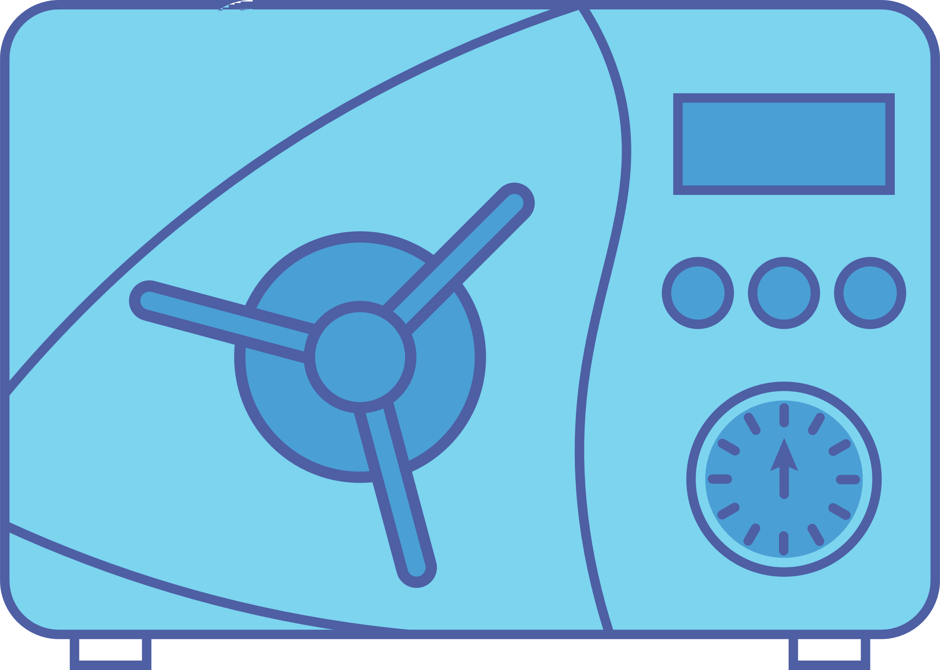
Sterilization
Sterilization
Disinfection
Cleaning
  Objects that enter certain places in the body
    Needles, catheters
  Pressure/steam, or chemicals
  Destroys ALL germs and forms of germs
Notes:
Script:
The last and highest level of germ removal is sterilization (ADVANCE). Sterilization must be done on (ADVANCE) any objects that may come into contact with areas of your body which are germ free such as your bladder and your circulator system that carries your blood. Items that must be sterilized before use include (ADVANCE) needles and catheters. While sterilization can be done using special chemicals, it is typically done by using a special machine that uses a combination of (ADVANCE) pressure and steam to heat items thoroughly, (ADVANCE) destroying all germs, including hardy germs and forms of germs that make them especially hardy. Sterilization is required of these items because if germs were to enter these special places in your body, your risk for an infection and severe illness are very high.
Know Before You Go!
Steam sterilizers, also known as autoclaves are used to sterilize critical items. You may not see an autoclave in a nursing home facility but if you do, please know it requires special training to use and requires special policies and procedures to ensure the equipment is operating correctly.
Chemical sterilants include ethylene oxide (EtO), hydrogen peroxide gas plasma (HPGP), vaporized hydrogen peroxide, and peracetic acid. Again, you will likely not find chemical sterilants in a nursing home facility but if you do they require special training an protocols for use as they have been associated with health issues if not used correctly.
Visit the CDC and NIOSH (National Institute for Occupational Safety and Health) for additional information
https://www.cdc.gov/niosh/topics/healthcarehsps/sterilants.html

Slide 16
Routine Cleaning Process
  Cleaning needed for disinfection and sterilization
    Combine cleaning and disinfection
  Best practice- keep a pattern!
    Work from top to bottom, clean to dirty
    One area to another
    Cleaning cloth use per room
      Avoid skipping & recontamination
Notes:
Script:
You see that cleaning (ADVANCE) is foundational to protecting the nursing home environment. For some surfaces, if they are not too dirty or soiled, it is recommended to (ADVANCE) combine cleaning and disinfection so they are done at the same time- for example using a disinfectant wipe on doorknobs. But cleaning is definitely not a step that can be skipped for either disinfection or sterilization! And when a nursing home community cleans both resident care items and general household surfaces in a resident’s room, it is always best practice to keep a pattern. So cleaning from top to bottom, (ADVANCE) clean to dirty, (ADVANCE) and working one area of the room to another area of the room. (ADVANCE) So for example, starting furthest from the bathroom, moving left to right in a room, leaving the bathroom (likely the most dirty and contaminated area) for last. It is also important to (ADVANCE) use multiple cleaning cloths in a room and not reuse cleaning cloths between rooms, especially resident rooms. (ADVANCE) Keeping a pattern and being careful how products like cleaning cloths are used helps the person who is cleaning from skipping any areas and also from possibly introducing contamination in areas cleaned.
Know Before You Go!
Studies have found that microfiber cloths provide superior cleaning compared to cotton cloths
If a facility uses the bucket method (the place disinfectant in a bucket) to clean resident rooms, a cleaning cloth should not be placed in the disinfectant bucket once it has been used in to clean and disinfect a resident’s room or any other area. So, no double dipping.

Slide 17

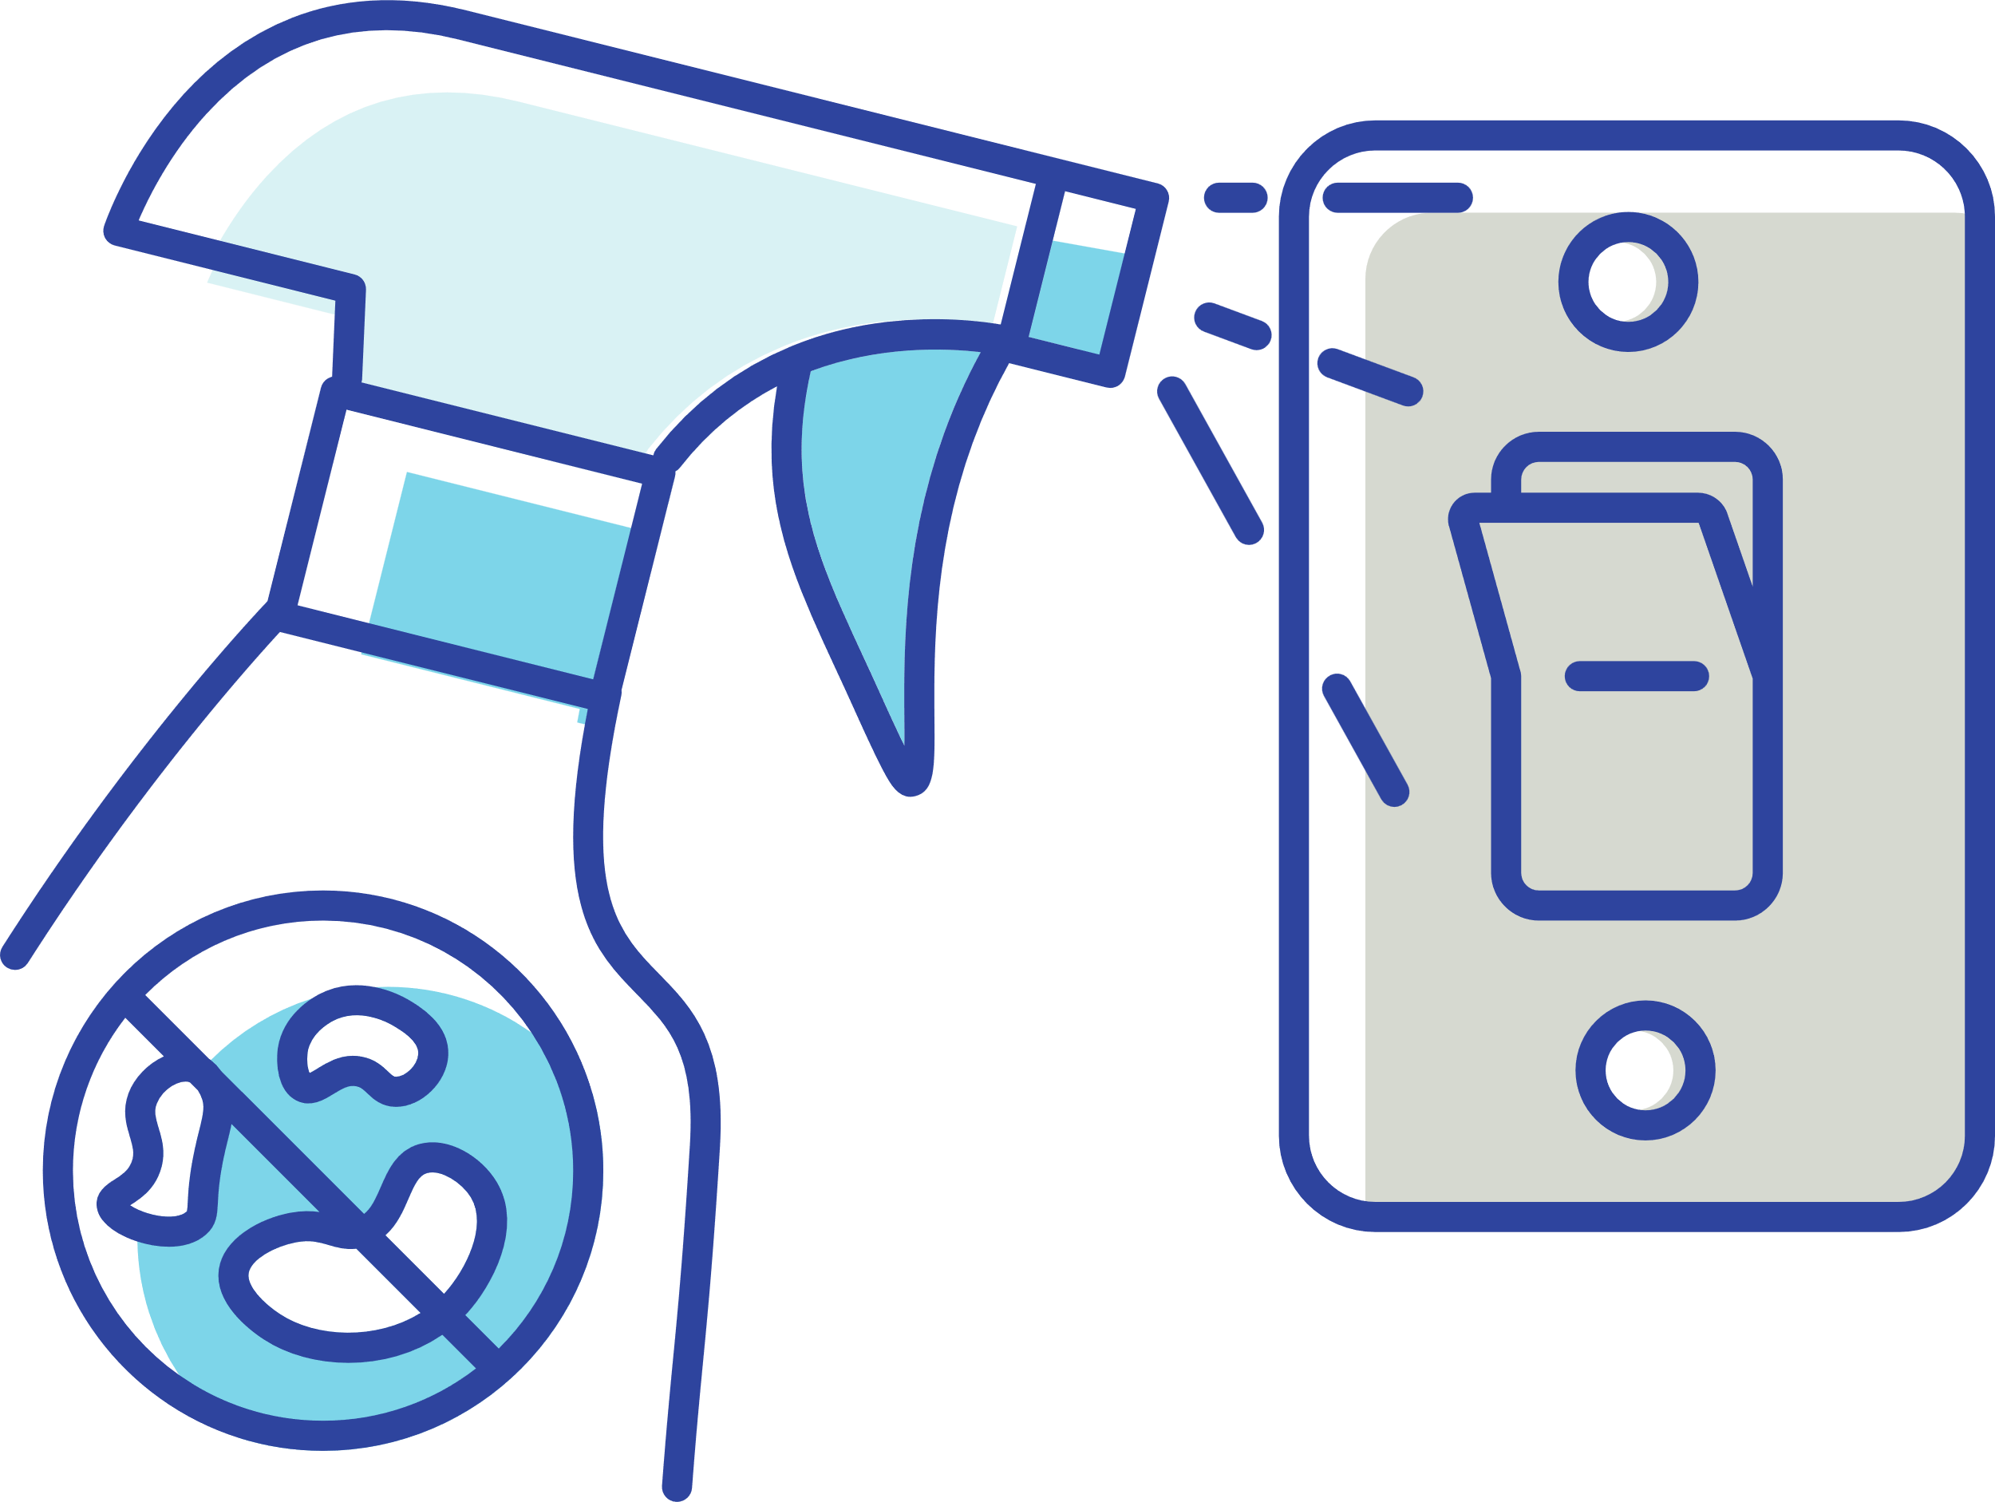

Policies, Procedures, and Products
  Policies & Procedures
    Routine cleaning & disinfection
      Resident care, high touch, special soiled
      Single-use, single resident items (insulin pens, blood glucose monitor)
    Written, reviewed, education, checked
  Products
    Hospital-grade, approved
    Specific “kill” and “contact” claim
    Ease of use and safety
Notes:
Script:
As mentioned at the beginning of this lesson, practices are very important in how germs spread in a nursing home community. That is why it is very important for nursing home communities to have specific policies and procedures (ADVANCE) in place that clearly write out (ADVANCE) the process for routine cleaning and disinfection. (ADVANCE) These policies must include how (ADVANCE) resident care and frequently touched, household surfaces will be cleaned and disinfected and how often. Nursing home communities must make it clear when items are (ADVANCE) single use items and are only to be used by one resident such as such as insulin pens and glucose monitors. Needles in these monitors should be sterile before use and again, the monitors themselves should not be shared between residents. In addition, there must be a policy and process for cleaning special items when they get soiled such as privacy curtains. Lastly, cleaning and disinfection policies and procedures must be (ADVANCE) written and accessible for everyone who will use them. These policies should be reviewed at least every year and updated as needed. Nursing home community staff that are responsible for any steps in the cleaning and disinfection process must have their knowledge and skills in applying the policies and procedures checked to ensure they are correctly following them.
Remember that in addition to the right practices, using the right products (ADVANCE) the right way is also important to prevent germ spread. Disinfectants should be hospital-grade, (ADVANCE) with a special label indicating it is approved to kill hardy germs that can be found in a nursing home community. The label and instruction should specifically stated (ADVANCE) how long the disinfectant needs to have contact with a surface to work correctly. Nursing home communities should select disinfectants that are easy to use, for example in a wipe or is easy to dilute before use. And of course, products should be as safe as possible for both residents and the staff who use the products.
Know Before You Go!
It is very important to stress that all needles, including those used in insulin pens and blood glucose monitors, should only be used one time, by one resident. And even monitors that seem that they can be used for more than one resident with a new needle should still only be used with one resident. CMS states this clearly in the CMS Appendix PP Guidance to Surveyors for Long-term Care Facilities. Please see the references section for additional information.
Resident care areas and equipment as well as frequently touched household surfaces and objects should be cleaned at least daily per CDC. CMS does not specifically state a frequency (only states routinely), but does stated that facilities should ensure infection control standards of practice should be based on “recognized guidelines”. Two major, recognized guidelines related to cleaning, disinfection, and sterilization in a healthcare environment, including nursing homes are:
CDC Guidelines for Disinfection and Sterilization in Healthcare Facilities (2008). https://www.cdc.gov/infectioncontrol/guidelines/disinfection/index.html
CDC Guidelines for Environmental Infection Control in Healthcare Facilities (2003). https://www.cdc.gov/infectioncontrol/guidelines/environmental/index.html
A great infection prevention long-term care self-checklist is provided by CMS and is a great checklist for you to become familiar with the requirements and standards related to infection prevention in nursing homes. Please use elements of this checklist when you visit your facility:
CMS QSO-20-03-NH. November 22, 2019. Attachment A Long-Term Care (LTC) Infection Control Worksheet. Infection Control Self-Assessment tool for nursing homes. https://www.cms.gov/files/document/qso-20-03-nh.pdf
Also, CMS has several surveyor checklists that can be helpful to understand long-term care requirements. These checklists can be found at the following website:
https://www.cms.gov/Medicare/Provider-Enrollment-and-Certification/GuidanceforLawsAndRegulations/Nursing-Homes. Please scroll to “Survey Resources” which is a zipped file. Once you unzip and open this file, it contains several helpful resources including Appendix PP State Operations Manual which details CMS requirements for nursing homes and folder “LTC Survey Pathways” that has several regulatory related checklists.

Slide 18


Checks and Balances (Surveillance)
  Balance procedures and practices
  Routine, ongoing, collection of information for improvement
    Surveillance
  Not punishment! Progress not perfection!
Outcome Surveillance
Infection Clusters
  Monitor: certain germs, antibiotic orders
Process Surveillance
Cleaning and Disinfection
  Monitor: observations, markers, amount of possible germs
Notes:
Script:
Balancing (ADVANCE) (ADVANCE) written procedures, so how things should be done to prevent germ spread, and practices, what is really being done to prevent germ spread, requires a system of checks and balances. Nursing homes are required to (ADVANCE) routinely monitor all practices related to preventing and controlling infections including cleaning and disinfection. This monitoring is known as surveillance. (ADVANCE) Surveillance requires ongoing collection of information for improvement. Again, this information is to improve practices, it is not to punish staff. (ADVANCE) There will always be room for progress as no one is perfect!
And there are so many things to remember and keep straight when in comes to cleaning, disinfection, and sterilization and the role everyone has in safeguarding the nursing home environment- including all staff and even residents! That is why there are two main types of surveillance: outcome (ADVANCE) and process (ADVANCE) surveillance. In outcome surveillance, a nursing home keeps an eye for possible (ADVANCE) clusters of infection to see (ADVANCE) if germs are spreading in the nursing home community. So a nursing home may monitor if there are more infection with certain types of germs or if antibiotics for a specific infections are being ordered more frequently. For the second type of surveillance, process surveillance, a nursing home is required to check to make sure the steps taken to prevent germ spread, such as cleaning and disinfection (ADVANCE), are taking place the way they should. For cleaning and disinfection, nursing homes (ADVANCE) can observe the cleaning and disinfection process to make sure it is done correctly as stated in the policies and procedures. Nursing homes can also use special makers to see if a surface was cleaned properly and even use special chemicals to check for excess germs on a surface after cleaning and disinfection.
Know Before You Go!
CMS states that nursing homes must establish a system for surveillance based upon nations standards of practice and a facility assessment. The facility should include a way to track and monitor the extent at which staff are following infection prevention and control policies and procedures and the need for correction. The facility “shall “ (indicating it is mandatory) establish process and outcome surveillance.
Process surveillance related to cleaning and disinfection can include direct observations of direct practices, fluorescent markers (such as markers that are not visible in normal light but visible with a special light; if cleaning and disinfection did not take place correctly, the marker will be visible after the process); or a method for quantifying the concentration of environmental organisms. One such method is ATP bioluminescence.
ATP, which stands for adenosine triphosphate, is a molecule that is found in all living cells and is important in providing cells with energy.
If a surface has been properly cleaned and disinfected, the level of ATP should be low.
Several different companies sell fluorescent markers and hygiene monitoring systems. There are no specific recommendations of which to use but a facility should ensure they instructions provided by the manufacturer are clearly written and provided, as well as how the monitoring system will be evaluated to ensure it is working properly (quality control).

Slide 19
Quality Care & Resident Rights
Quality
Infection Prevention & Control
Resident Rights
Certain germs
Protect nursing home environment
Infection Prevention & Control
Resident Rights
Informed and Involved
Notes:
Script:
(ADVANCE) So now that you know certain germs are more commonly found in nursing homes and how to protect the nursing home community environment from those germs- what does that have to do with resident rights and responsibilities?
All residents, those closest to them including the nursing home community’s staff and administration want high quality care and deserve an environment that promotes high quality care (ADVANCE) - reaching the highest level of quality (ADVANCE) in a nursing home community includes taking all steps to prevent and control infections (ADVANCE). And as all nursing home communities experienced during the COVID-19 pandemic, infections occurring not only inside, but also outside of the nursing home community, can result in changes that impact a resident’s rights (ADVANCE) such as visitation and freedom to participate in activities. These changes can have a major impact on a resident’s overall well-being.
When nursing home communities work side by side with residents and those closest to them such as family members to prevent and control infections, this demonstrates a commitment to quality care that preserves and promotes resident rights. And when resident rights are protected and preserved, this also strengths a nursing home community’s ability to prevent and control infections.
When infections are prevented and controlled to delivery high quality care, two major resident rights are protected: being informed and involved. (ADVANCE)
Know Before You Go!
Federal regulations related to infection prevention (§483.80) establish minimums standards in these areas. See the References and resource for CMS documents.
Federal surveyors use F tags to document and communicate violations to quality care. Infection prevention covers F880-F887. See the References and resource for CMS documents.

Slide 20
Resident & Advocate: Rights & Responsibilities
  Informed
    Policies & procedures
    Practices
  Involved
    Education
      Plan
      Policies & Procedures
Notes:
Script:
Residents have the right to (ADVANCE) be informed regarding nursing home policies and procedures which prevent and control germs in the nursing home community, such as a policy for the frequency and method of routine cleaning and disinfection. Residents also have the right be informed about how the nursing home monitors practices in the nursing home to ensure they are in alignment with these policies & procedures.
(ADVANCE) Residents also have the right (ADVANCE) to be involved in education that helps them understand the nursing home’s plan for safeguarding the nursing home environment, including any specific policies and procedures in which they are expected to play an active role to prevent the spread germs in the nursing home community.
Know Before You Go!
Resident and advocates have rights and responsibilities when it comes to safeguarding the nursing home community. They have the right to have be informed and involved.
CMS states that facilities “must develop written policies and procedures for the provision of infection prevention and control. These policies must define and explain standard precautions and their application during resident care activities." Standard precautions include environmental cleaning and disinfection.
Cleaning and disinfection include frequently touching or visibly soiled surfaces in common areas, resident rooms, and rooms after a resident has been discharged (terminal cleaning).
Resident rooms should be cleaned routinely, with high-touch surfaces cleaned daily. Other horizontal surfaces that are not frequently touched, such as floors, window sills, walls, and privacy curtains, should be cleaned and disinfected regularly.
Per CMS, privacy curtains should be changed when visibly dirty, laundered, and disinfected per the manufacturer’s instructions.
Terminal cleaning includes cleaning all surfaces, including

Slide 21
Nursing Home Requirements: Infection Prevention & Control
  Infection control policies and procedures based on recognized guidelines
  As needed and at least annually, review and revise based on changes to resident infection risk
  Consider changes or trends within the nursing home and general community which may change resident infection risk
Strong Infection Prevention and Control Program
Federal and State Law Requirements
Notes:
Script:
(ADVANCE) Quality care can only be achieved when nursing homes have a strong program in place to prevent and control infections. Federal and state laws require nursing homes to have: (ADVANCE) 1) current infection control policies and procedures, including those related to cleaning and disinfection, based on recognized guidelines; (ADVANCE) 2) as necessary and at least annually, review and revise policies and procedures based on possible changes to infection risks in residents, and (ADVANCE) 3) when reviewing and revising policies and procedures, consider changes or trends, including infection trends with multidrug-resistant organisms, both within the nursing home as well as the general community where the nursing home is located.
Know Before You Go!
Be familiar with the handout entitled “Infection and Control: Regulations and Requirements”; this handout is based on the CMS State Operations Manual Appendix PP- Guidance to Surveyors for Long-Term Care Facilities (Appendix PP). Regulations related to infection prevention & control and standard precautions which include cleaning and disinfection can be found in §483.80 Infection Control. See the References and resource for CMS documents.

Slide 22


Ms. Johnson and Mr. Moore
  Informed
    Cleaning and disinfection policies and practices
    Monitoring
  Involved
    Education regarding cleaning and disinfection
Notes:
Script:
So let’s go back to Ms. Johnson and Mr. Moore. They were both concerned about a recent increase in antibiotic resistant bacterial infections in the nursing home, so they decided to find out more about what the nursing home does to protect residents and their environment from these germs. As the president of the resident council, Mr. Moore takes the lead (ADVANCE). With the help of the nursing home administrator and Steven, the Environmental Services Manager (ADVANCE), Mr. Moore is informed (ADVANCE) about how cleaning and disinfection are done the nursing home. Steven invites Mr. Moore to a training session, where housekeeping staff and nursing staff learn the best way to clean and disinfect both resident care items and general household surfaces. The staff also learn who is responsible for cleaning and disinfecting specific items and when this should be done. Steven also informs(ADVANCE) Mr. Moore that staff use a daily cleaning and disinfection checklist (ADVANCE) to help them track what areas have been cleaned and that the correct cleaning and disinfection products are being used. In addition, Steven informs Mr. Moore that cleaning and disinfection practices are monitored by observing staff at least one a week and feedback is provided to each person and during general, weekly staff meetings.
Mr. Moore now feels he has been involved (ADVANCE) in understanding the steps the nursing home takes to prevent germ spread, and they seem to be doing a good job to prevent the spread of germs, including the antibiotic resistant bacteria responsible for recent infections. He invites Steven to the next resident council meeting so he can educate (ADVANCE) the other residents regarding cleaning and disinfection in the nursing home and the role residents can play in safeguarding the nursing home community.
Know Before You Go!
Facilities are required to conduct regular training and monitoring of cleaning and disinfection as well as establish both process and outcome surveillance.
It is important to stress that residents can play a role in preventing the spread of germs in a nursing home by being educated and aware of the nursing home’s policies and procedures.

Slide 23
Discussion
  Have you seen any practices in this nursing home that are different than what you learned in this lesson? What are those practices?
  Have you been involved in education regarding your role in preventing the spread of germs in this nursing home?
  What role do you think residents play in keeping the nursing home environment safe from germ spread?
Notes:
Script:
Now that we covered this lesson on safeguarding the nursing home environment and saw what happened with Mr. Moore, let’s talk a little bit about what we learned. (read selected discussion points)
Ombudsman Notes:
Discussion & Advocacy Points- After watching this lesson or having residents/family members watch the lesson, consider the questions below to reinforce learning and promote discussion. Feel free to edit this slide to use one or more questions:
Have you seen any practices in this nursing home that are different from what you learned in this lesson? What are those practices?
The purpose of this question is to have the participants reflect on what they learned, establish understanding, and apply the information. In addition, this question is to stimulate discussion regarding any issue or concern regarding the nursing home environment.
Have you been involved in education regarding your role in preventing the spread of germs in this nursing home?
The purpose of this question is to emphasize that residents as well as family members should receive some basic education so they understand what a nursing home community does to keep the nursing home environment safe and the resident’s role in this.
What role do you think residents play in keeping the nursing home environment safe from germ spread?
The purpose of this question is to tie the previous two questions together: residents and their family members should receive education about what the policies and practices are in the nursing home regarding cleaning and disinfection, and that should include any expectations the facility has in terms of practices. For example, are residents expected to place dirty clothes in a specific container? Are family members expected to use specific cleaning and disinfectant wipes if they want to clean a resident’s room? Are residents and family members expected to notify environmental and housekeeping staff if they notice an issue related to cleaning and hygiene? In addition, it is important to stress that residents have the right to live in an environment that is "homelike,” and the facility must balance an environment that is clean and safe while also allowing residents to have personal items that support their overall well-being and independence.

Slide 24
Advocacy: Next Steps
  Education
    Nursing home specific risk assessment
    Nursing home specific policies and procedures
  Engagement
    Resident or family council to review policies and monitoring
  Empowerment
    Quality assurance and assessment committee (QAA committee)
    Resident and/or family member role in monitoring
Notes:
Script:
So what are the next steps you can take to receive the highest quality of care and preserve your rights?
Ombudsman Notes:
After the discussion be sure to emphasize at least one next step residents and family members can take receive high quality care and preserve their rights. How can you assist and provide follow-up for this step?
Recall that in the ICARE program, participants move in small, realistic steps:
1) Education (defining and understanding infection prevention and quality care).
2) Engagement (begin incorporating direct interaction with nursing home leadership and staff on infection prevention quality measures).
3) Empowerment (motivate and support participants to take an active role in improving quality care through infection prevention related quality improvement project or other quality care initiatives).
Feel free to edit this slide to use one or more advocacy steps. It is very important to stress the role of the QAA (or the name of the committee commonly used in your state) as most residents and family members are unaware of this committee. Advocacy next steps may include:
Provide clarification regarding when a resident can refuse treatment, care, or services and what that means for the resident. A resident’s refusal cannot put anyone else in the facility at risk
Ask the facility if they have conducted a facility risk assessment and review with residents and family members. There are several tools available online from governmental and non-for profit agencies to see what should be in a risk assessment:
CMS, Quality Improvement Organizations, Facility Assessment Tool: https://qioprogram.org/facility-assessment-tool
Leading Age, Facility Assessment Template: https://leadingageil.org/resources/3%20Facility%20Assessment%20Template%20with%20Instructions.pdf
Note this facility specific risk assessment is broader and encompasses infection control. As part of this broad risk assessment, an infection prevention and control assessment using the CDC ICAR tool should also be done: https://www.cdc.gov/infectioncontrol/pdf/icar/nursing-home-icar-facilitator-guide.pdf
Ask the facility for their infection control policies and procedures related to cleaning and disinfection, as well as any tools used for monitoring.
Suggest forming a resident or family council if not currently in place and having the nursing home administrator or other staff member review and discuss the facility risk assessment, infection prevention policies and procedures, and monitoring tools used
Have a member of the QAA committee discuss corrective action steps taken with any monitoring data and what the residents and family members can do to assist in this process. For example, can they provide feedback using a survey or tool? See the handout with this lesson for an example of a possible tool.

Slide 25
This project is supported by the Health Resources and Services Administration (HRSA) of the U.S. Department of Health and Human Services (HHS) under grant number U1QHP28735. Its contents are solely the responsibility of the authors and do not necessarily represent the official view of the Health Resources and Services Administration or the U.S. Department of Health and Human Services.
https://www.unthsc.edu/ICARE
ICARE
Infection Control Advocate & Resident Education
Notes:
Script:
Thank you watching this lesson, please see the ICARE website for additional lessons, information, and support.
References & Resource:
Infection Prevention Guide to Long-Term Care, 2nd Edition. Chapter 9: Environmental Services. Association for Professionals in Infection Control and Epidemiology; 2019. Arlington, VA
Infection Prevention Guide to Long-Term Care, 2nd Edition. Chapter 10: Water Management Program to Prevent Waterborne Diseases. Association for Professionals in Infection Control and Epidemiology; 2019. Arlington, VA
CDC Nursing Home Infection Preventionist Training Course. Module 11B- Environmental Cleaning and Disinfection. https://www.train.org/cdctrain/training_plan/3814
CMS QSO-20-03-NH. November 22, 2019. Attachment A Long-Term Care (LTC) Infection Control Worksheet. Infection Control Self-Assessment tool for nursing homes. https://www.cms.gov/files/document/qso-20-03-nh.pdf
CDC Guidelines for Disinfection and Sterilization in Healthcare Facilities (2008). https://www.cdc.gov/infectioncontrol/guidelines/disinfection/index.html
CDC Guidelines for Environmental Infection Control in Healthcare Facilities (2003). https://www.cdc.gov/infectioncontrol/guidelines/environmental/index.html
CMS Appendix PP Guidance to Surveyor for Long-Term Care Facilities: 483.10- Resident Rights (F550- Resident Rights; F584- Safe/Clean/Comfortable/Homelike Environment); 483.75- QAPI; 483.80- Infection Control (F880 Infection Control); https://www.cms.gov/files/document/appendix-pp-guidance-surveyor-long-term-care-facilities.pdf
United States Environmental Protection Agency, Select EPA-Registered Disinfectants. https://www.epa.gov/pesticide-registration/selected-epa-registered-disinfectants
CDC, “Environmental Cleaning and Disinfection: Principles of Infection Transmission and the Role of the Environment”. https://www.cdc.gov/infectioncontrol/pdf/strive/ec101-508.pdf
CDC “Implementation of Personal Protective Equipment (PPE) Use in Nursing Homes to Prevent Spread of Multidrugresistant Organisms (MDROs)”. July 12, 2022. https://www.cdc.gov/hai/pdfs/containment/PPE-Nursing-Homes-H.pdf
CDC, Clinical Questions about COVID-19: Questions and Answers, Infection Control “Which Procedures are considered aerosol generating procedures in healthcare settings? https://www.cdc.gov/coronavirus/2019-ncov/hcp/faq.html#Infection-Control
CDC, Cleaning and Disinfection Strategies for Non-Critical Surfaces and Equipment. https://www.cdc.gov/infectioncontrol/pdf/strive/ec102-508.pdf
CDC, Healthcare-Associated Infections, Reduce Risk from Surfaces. https://www.cdc.gov/hai/prevent/environment/surfaces.html

