Slide 1
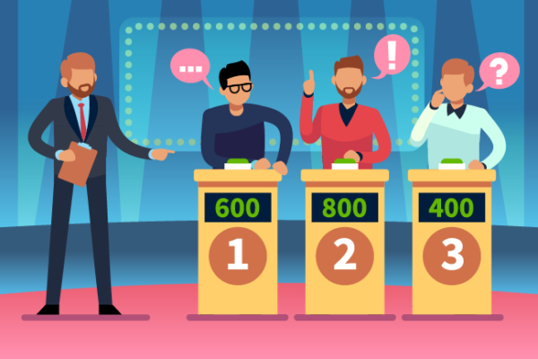
Web-Lit-Legit
#KnowTruthFromTrash

Slide 2
L-last reviewed? Is it Up-to-Date? | E-exists, why does it exist? | G-good, is it a credible source? | I-source? Research-based? | T-too good to be true? What is promised? | Ask Me 3?
10 | 10 | 10 | 10 | 10 | 10
20 | 20 | 20 | 20 | 20 | 20

Slide 3
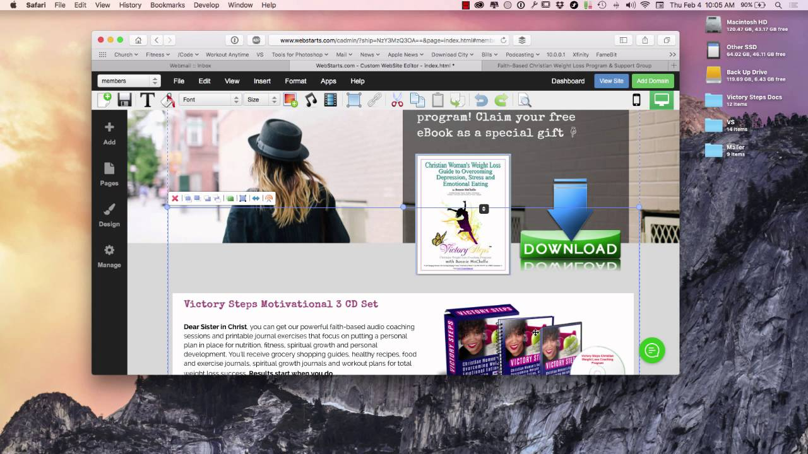
Question 1 - 10
Where is the information about a site being last reviewed usually located?

Slide 4

Answer 1 – 10
At the bottom of the page.

Slide 5
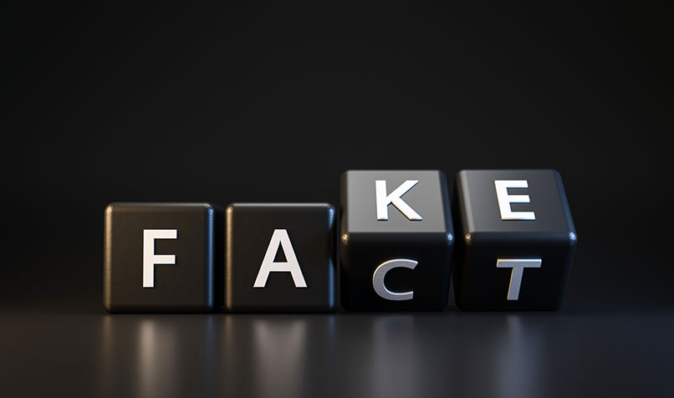
Question 1 - 20
The website ‘We Know Teens’ was last updated in 1965.
Would you consider the content ‘Truth or Trash’?

Slide 6
Answer 1 – 20
Trash, because truthful websites keep their sites up-to-date.
This site probably does not know teens of today’s world.

Slide 7
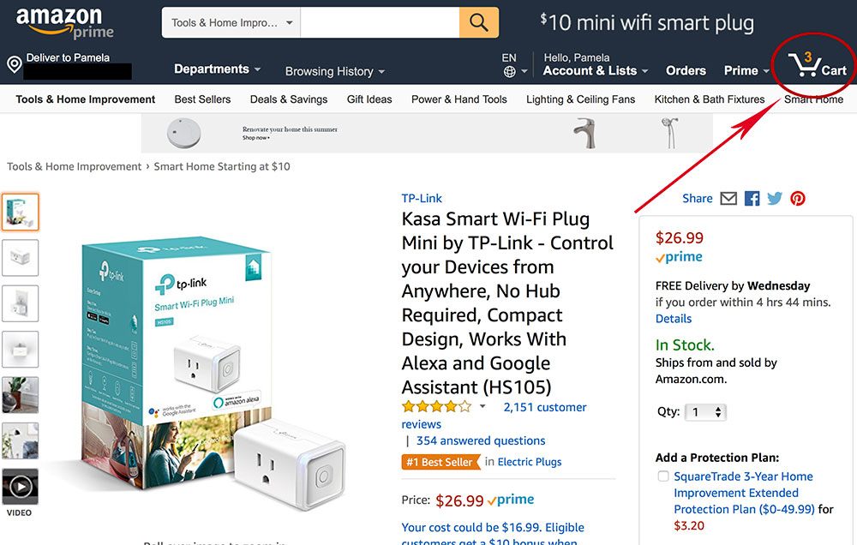
Question 2 - 10
What does a shopping cart on a site usually indicate?

Slide 8
Answer 2 – 10
A shopping cart usually indicates that the site is trying to sell you something.
Therefore, a health website selling something would be considered Trash.

Slide 9
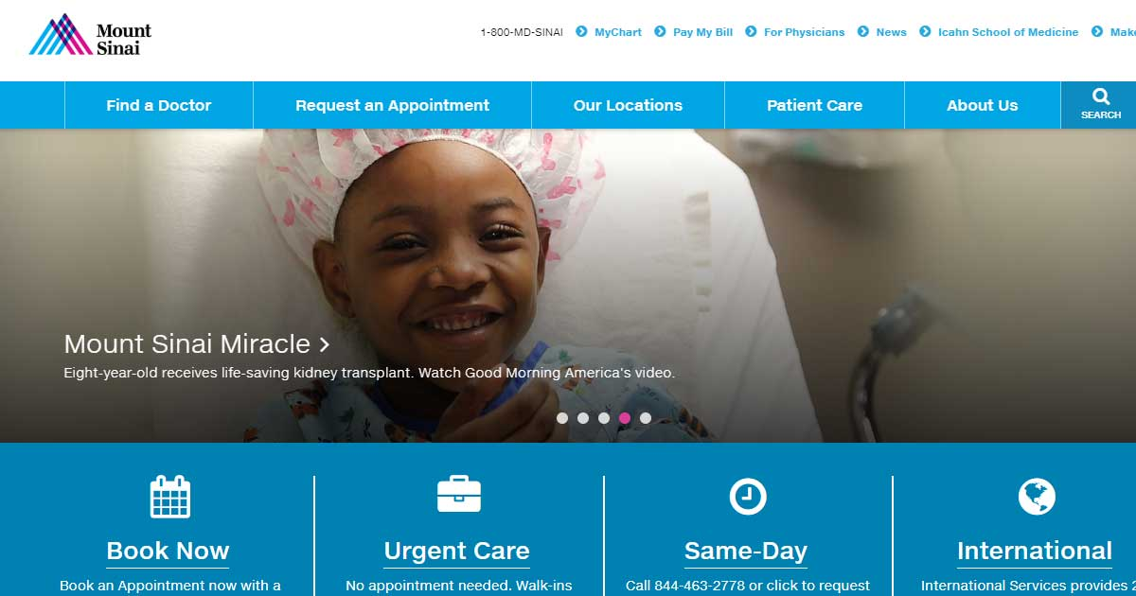
Question 2 - 20
If a site is run by experts in the health field is it considered ‘Truth or Trash’?

Slide 10
Answer 2 – 20
Truth, because truthful websites are always backed by credible experts.

Slide 11

Question 3 - 10
Would you consider the National Library of Medicine a reliable source?

Slide 12
Answer 3 – 10
Yes, because it is a government website prepared by experts in the field and backed by credible research.

Slide 13
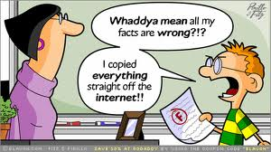
Question 3 - 20
What makes a website credible?

Slide 14
Answer 3 – 20
A website is credible if it has all of the elements of the LEGIT acronym.
Remember LEGIT:
L – Last reviewed?
E – Why does it Exist?
G – Good, is it credible source?
I – Information science-based?
T – Trying to sell you something?

Slide 15

Question 4 - 10
If an article about healthy relationships on the ‘Kids Health’ website and is reviewed by a licensed psychologist, is this article ‘Truth or Trash’?

Slide 16
Answer 4 – 10
Truth, because a reliable source is always reviewed by professionals in that field.

Slide 17
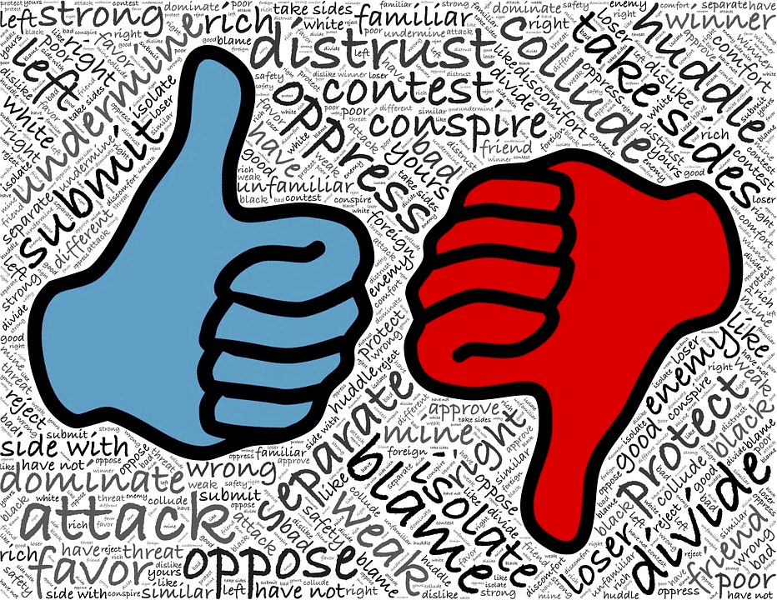
Question 4 - 20
If someone writes an article about eating disorders based on their personal opinion, is it considered ‘Truth or Trash’?

Slide 18
Answer 4 – 20
Trash, because only trash websites are provided by authors that have no credentials to back up their credibility.

Slide 19

Question 5 - 10
Is a website that sells your personal information considered ‘Truth or Trash’?

Slide 20
Answer 5 – 10
Trash, because a truthful website would not collect or sell your personal information.

Slide 21
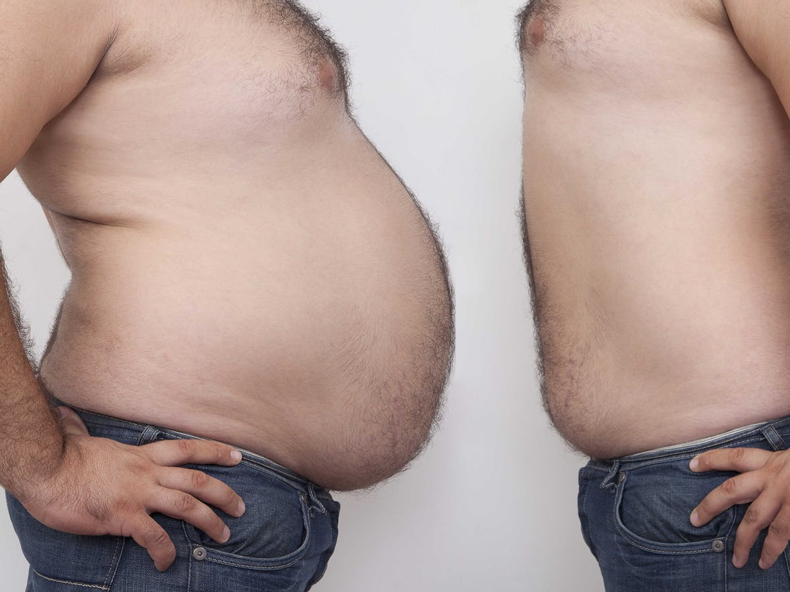
Question 5 - 20
If a site is promising that you will lose 10 pounds in 10 days by purchasing their product, is it considered ‘Truth or Trash’?

Slide 22
Answer 5 – 20
Trash, because it is trying to sell you something and it is promising offers that are too good to be true.

Slide 23

Question 6 - 10
What are the three questions you should always ask your healthcare provider?

Slide 24
Answer 6 – 10
What is my main problem?
What do I need to do?
Why is it important for me to do this?

Slide 25

Question 7 - 20
What should you do if you don’t understand your healthcare provider’s instructions?

Slide 26
Answer 7 – 20
Ask questions or ask more questions.
People should not feel rushed or embarrassed as it’s important to understand your health needs.

